Slide 1
South Korea’s Dog Meat Industry –
A Model For Change
13th October 2023
Lola Webber
Campaign Director – Ending the Dog Meat Trades

Slide 2
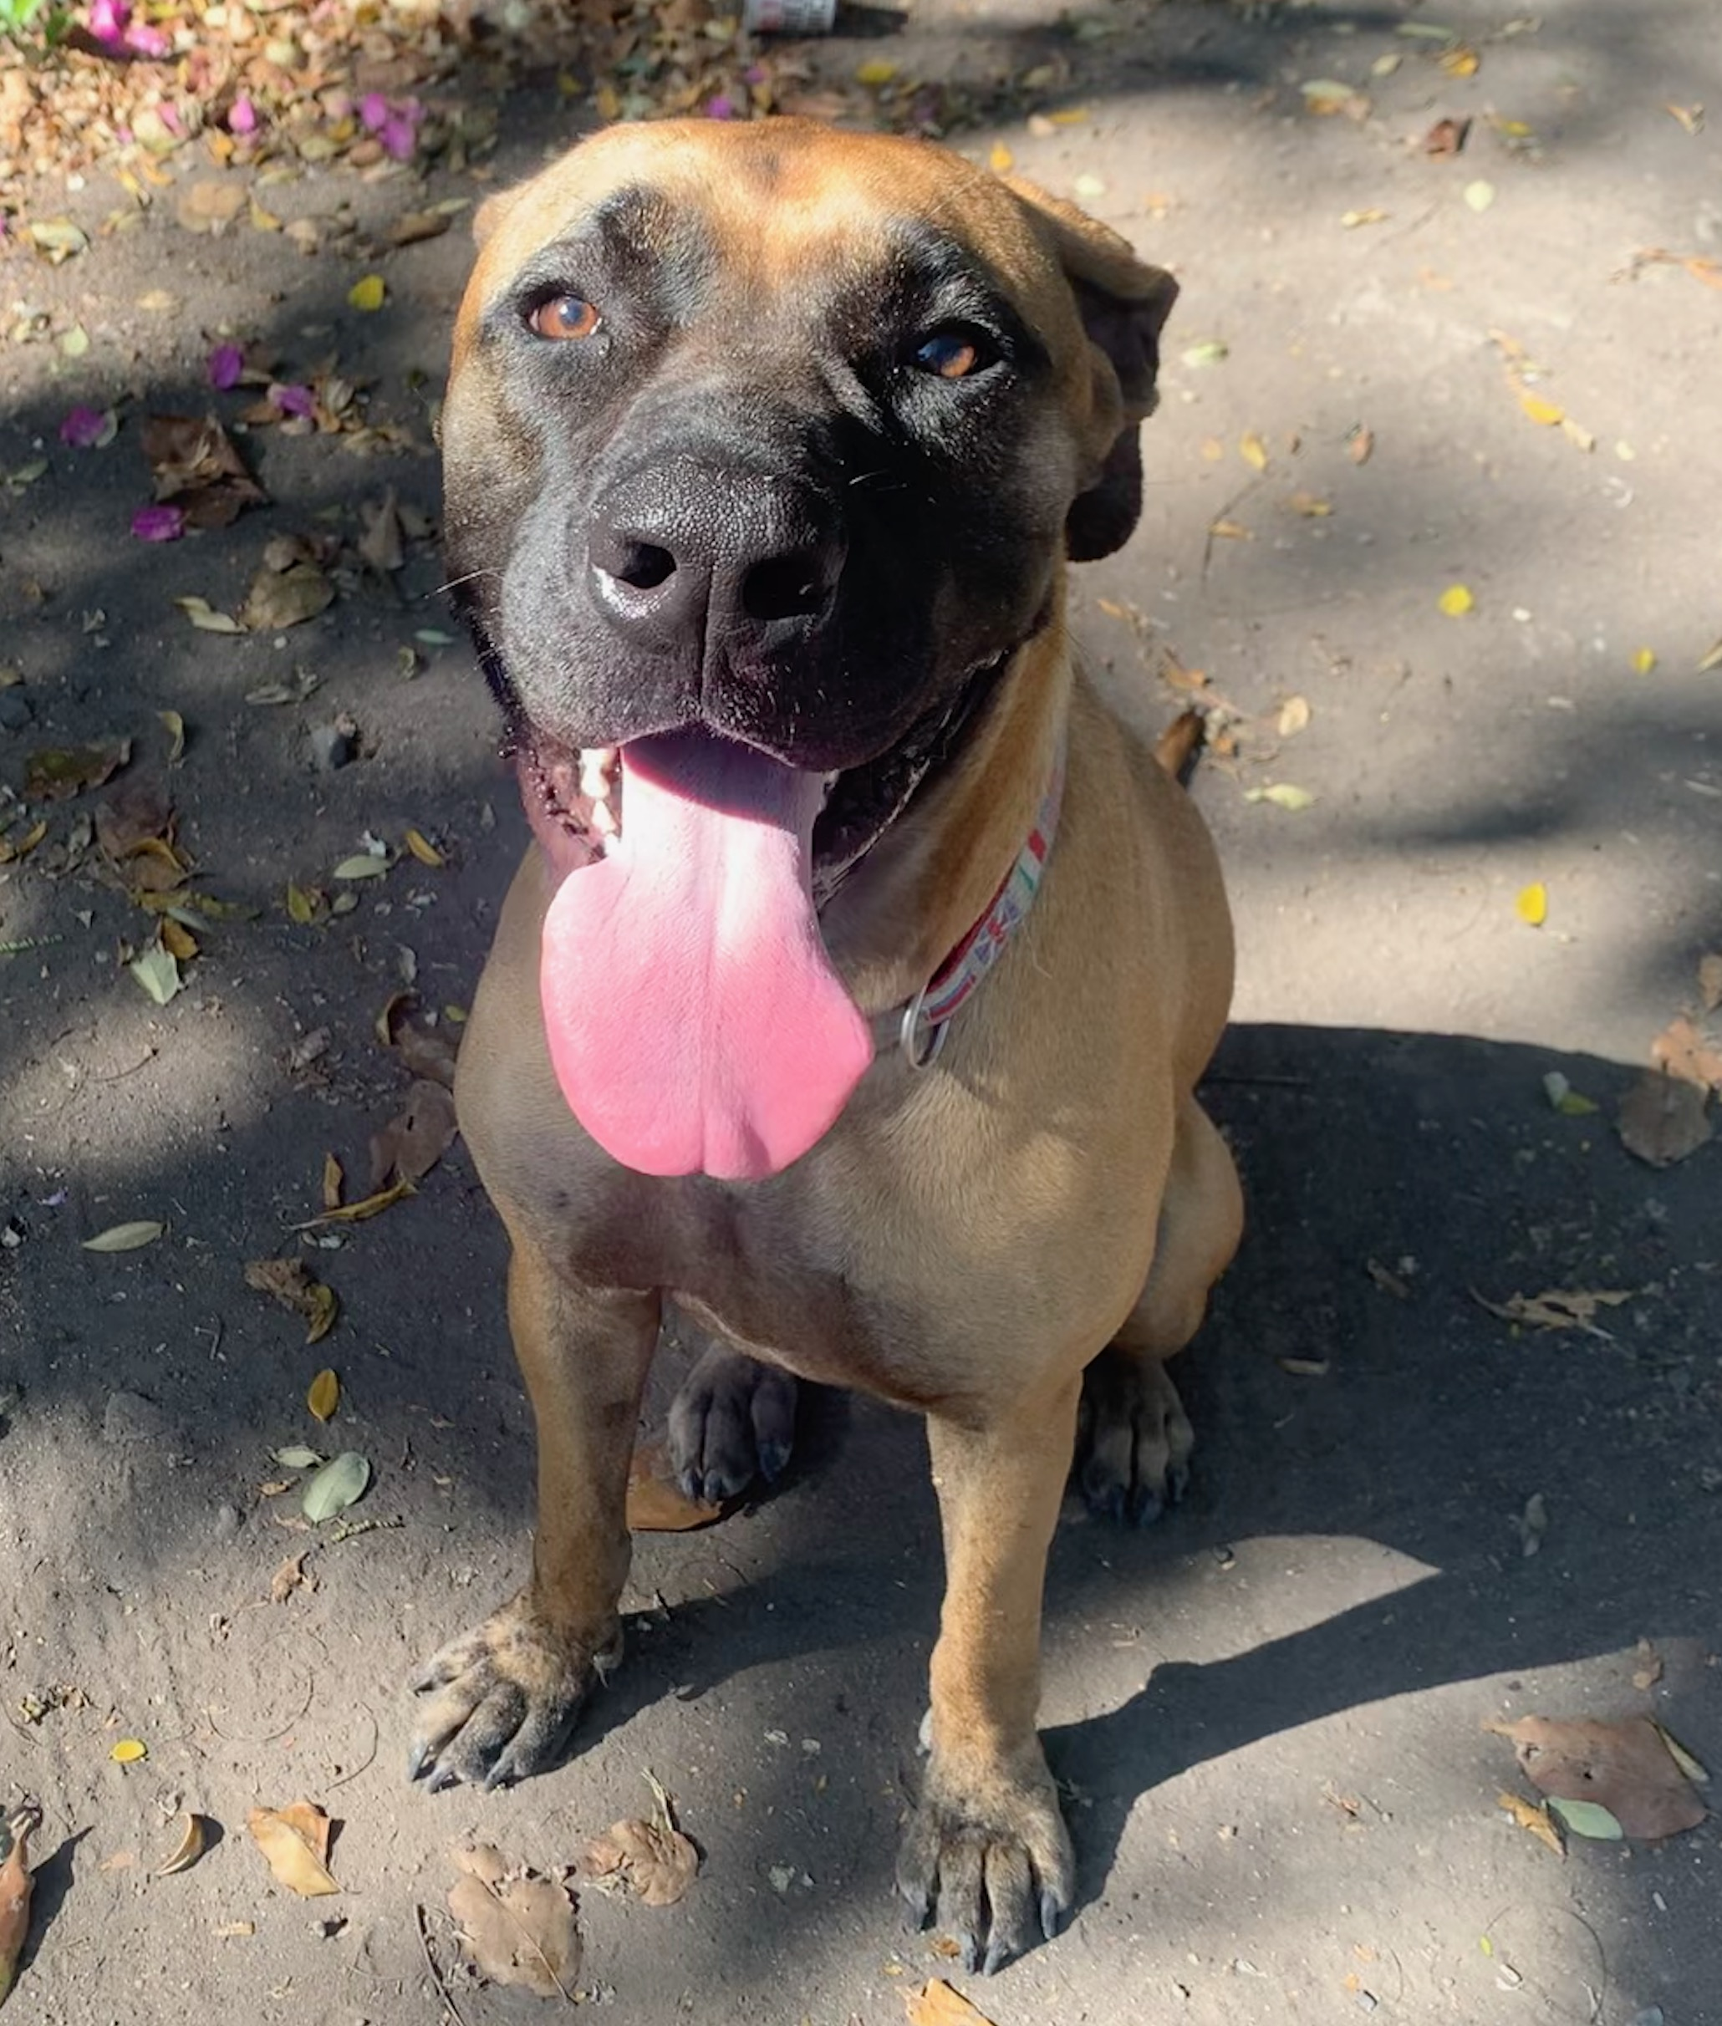
Presentation Overview
South Korea’s dog meat industry
  Scale & operations
  Drivers and motivations for consumption
Campaign strategy
  Models for Change Program: Why & How
Progress & developments
2

Slide 3
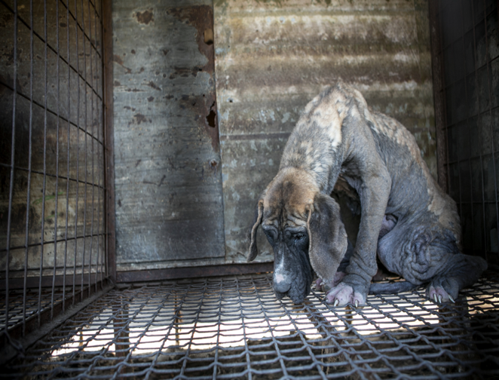
South Korea's Dog Meat Industry
Intensive farming, involving up to 1 million dogs
Lifelong confinement
Inadequate food/water
No veterinary care – high mortality
Cruel slaughter

Slide 4
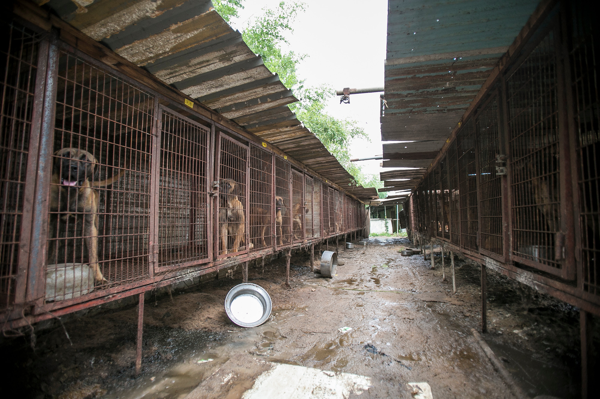
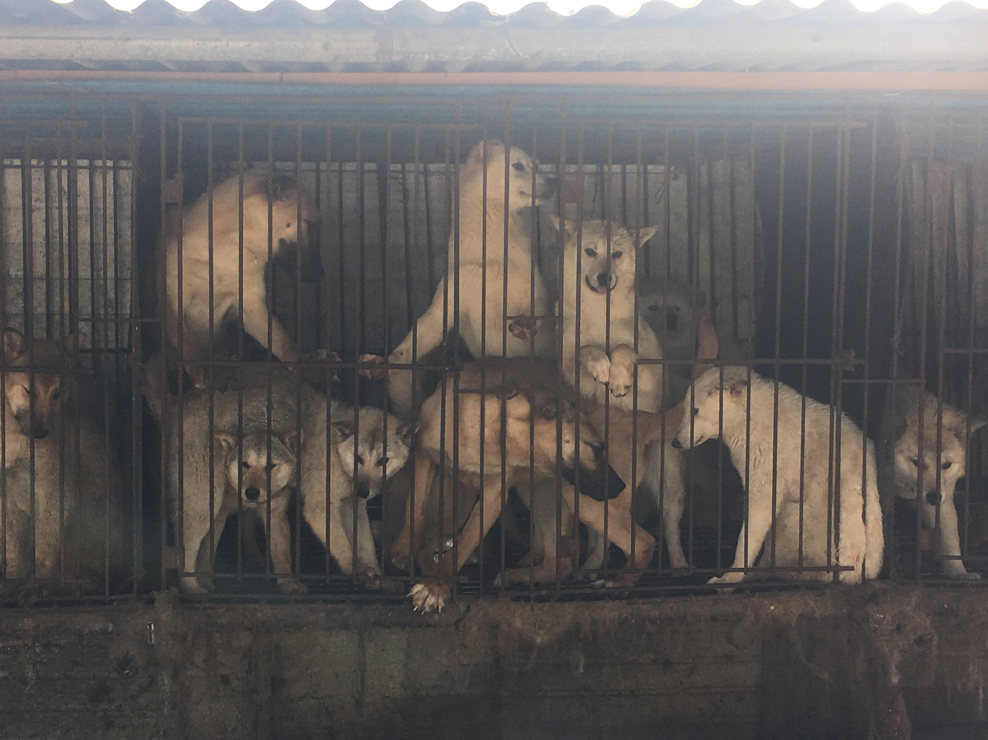
South Korea’s Dog Meat Industry
Consumption linked to customs, medicinal, and dietary practices
  E.g. Bok Nal days
Thousands of dog meat-selling restaurants (largely seasonal)
“Pet dogs” vs “Meat dogs” dichotomy
4

Slide 5
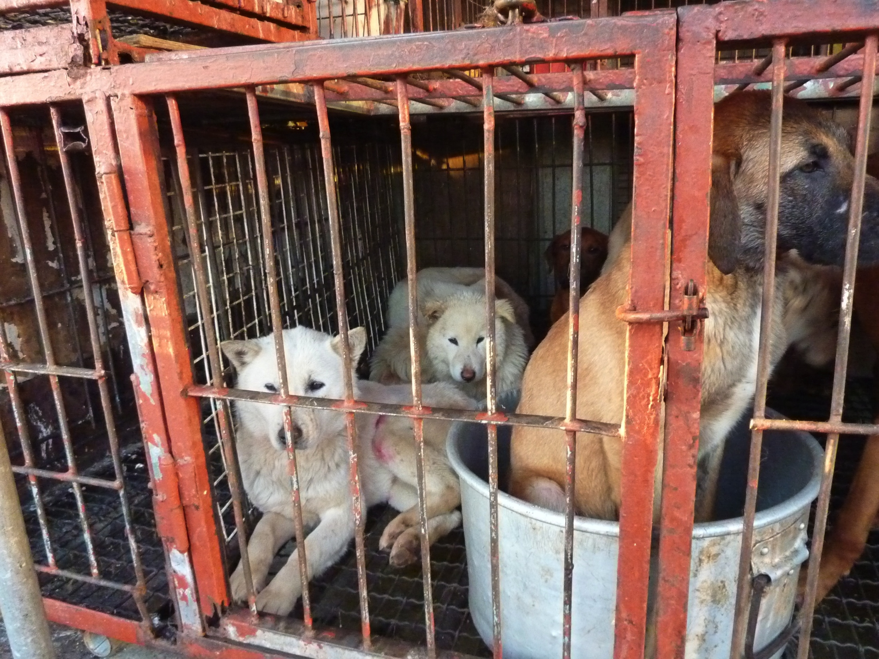
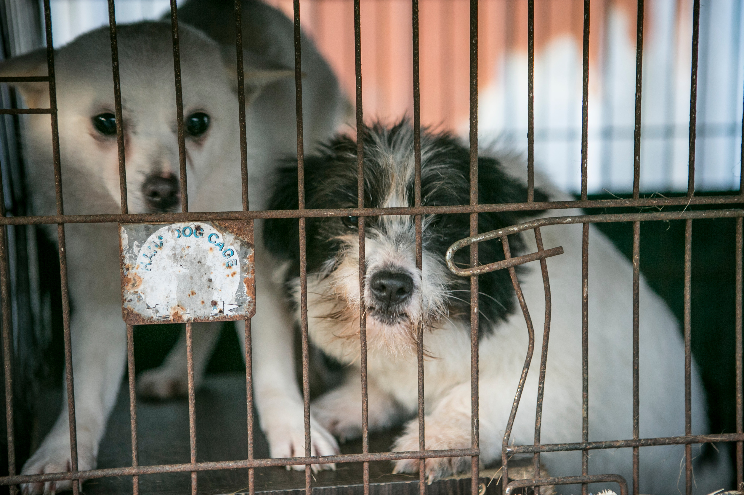
“Meat dogs” vs. “Pet dogs”
The dual perception of dogs in South Korea
5

Slide 6
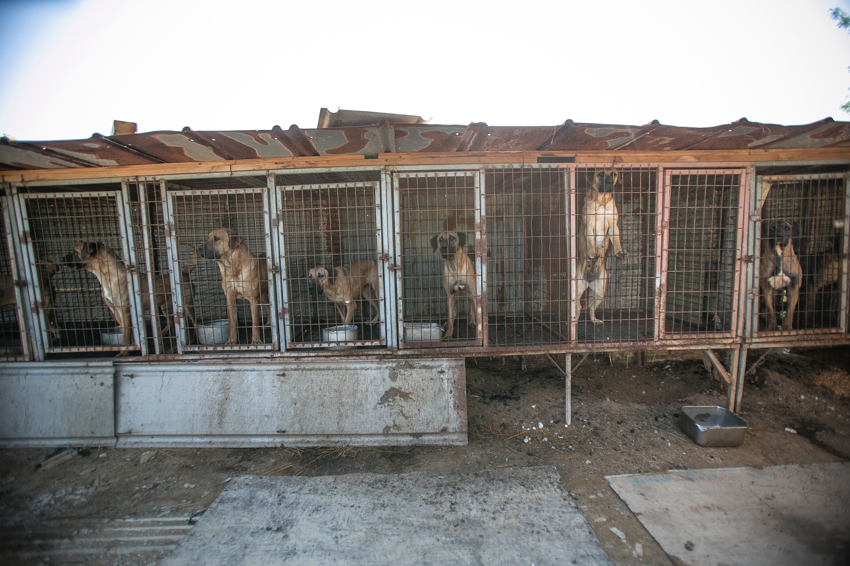
Legislation
Legal limbo” – neither legal nor illegal
Neither explicit recognition of dogs as food, nor a clear ban on the sale or slaughter of dogs for food.
No specific law governing the slaughter and sale of dogs for human consumption.
Animal Protection Act applicable
Inadequate enforcement and weak penalties
Industry calling for listing of certain breeds of dogs as “livestock” → rejection by AP movement
6

Slide 7
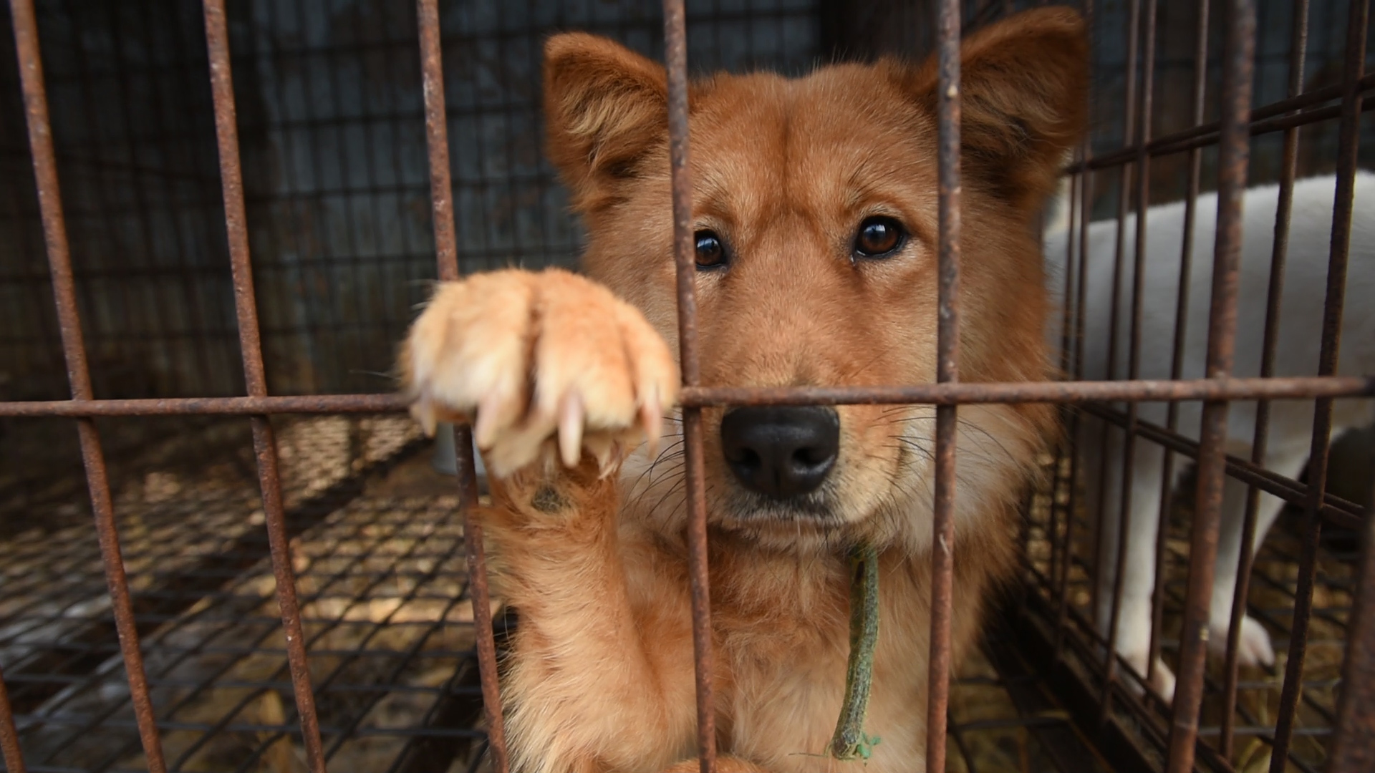
Campaign Strategy
To dispel the myths that serve to protect the industry and identify solutions for industry workers
Dispel dog dichotomy
Discredit unproven medicinal claims and encourage alternatives to dietary traditions such as bosintang
Highlight cruelty and dangers
Promote compassion & respect for all companion animals
Work with the industry we wanted to change so as to change the discourse – Models for Change Program
Work with legislators to develop & introduce holistic ban nationwide
CONFIDENTIAL | For internal use only by the Humane Society family of organizations
7

Slide 8
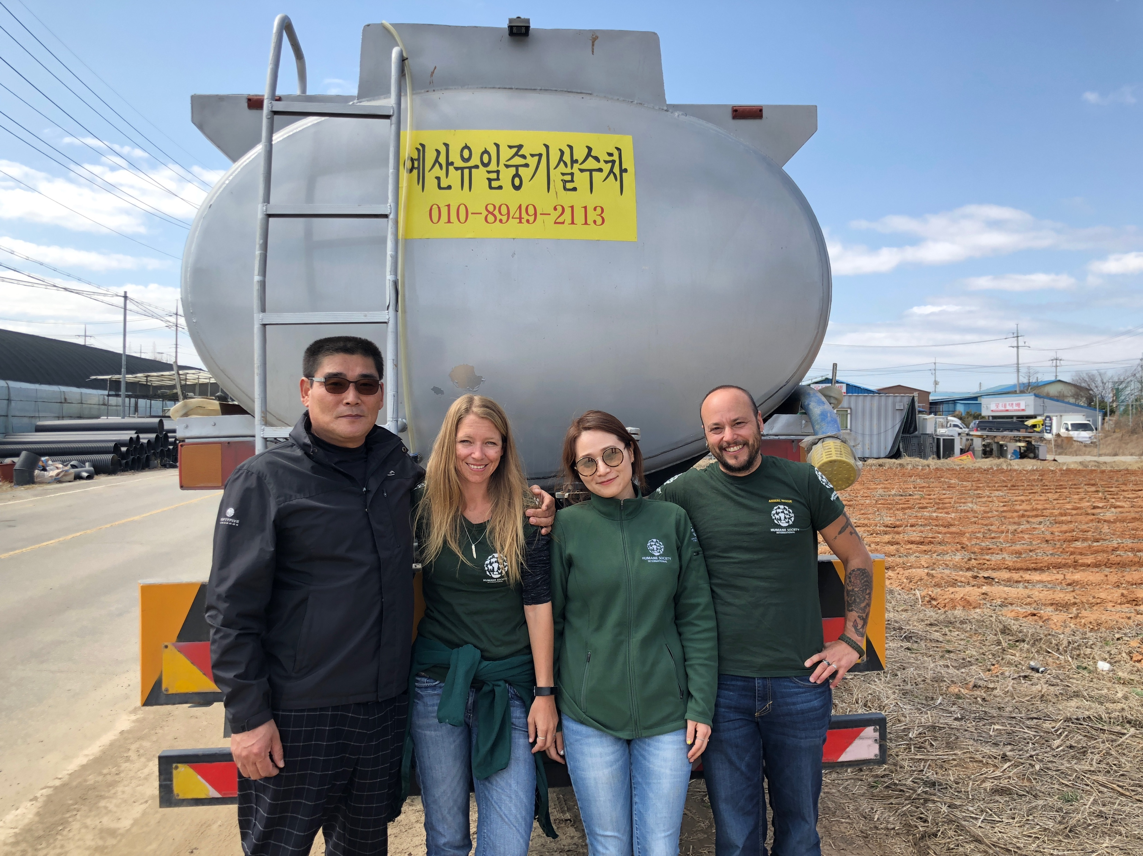
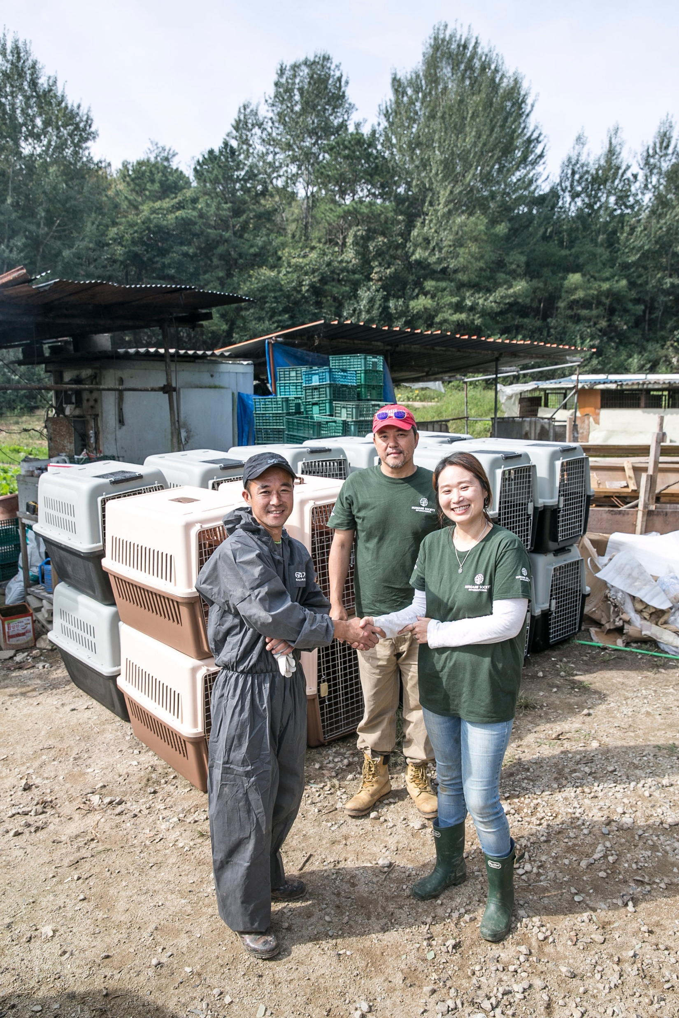
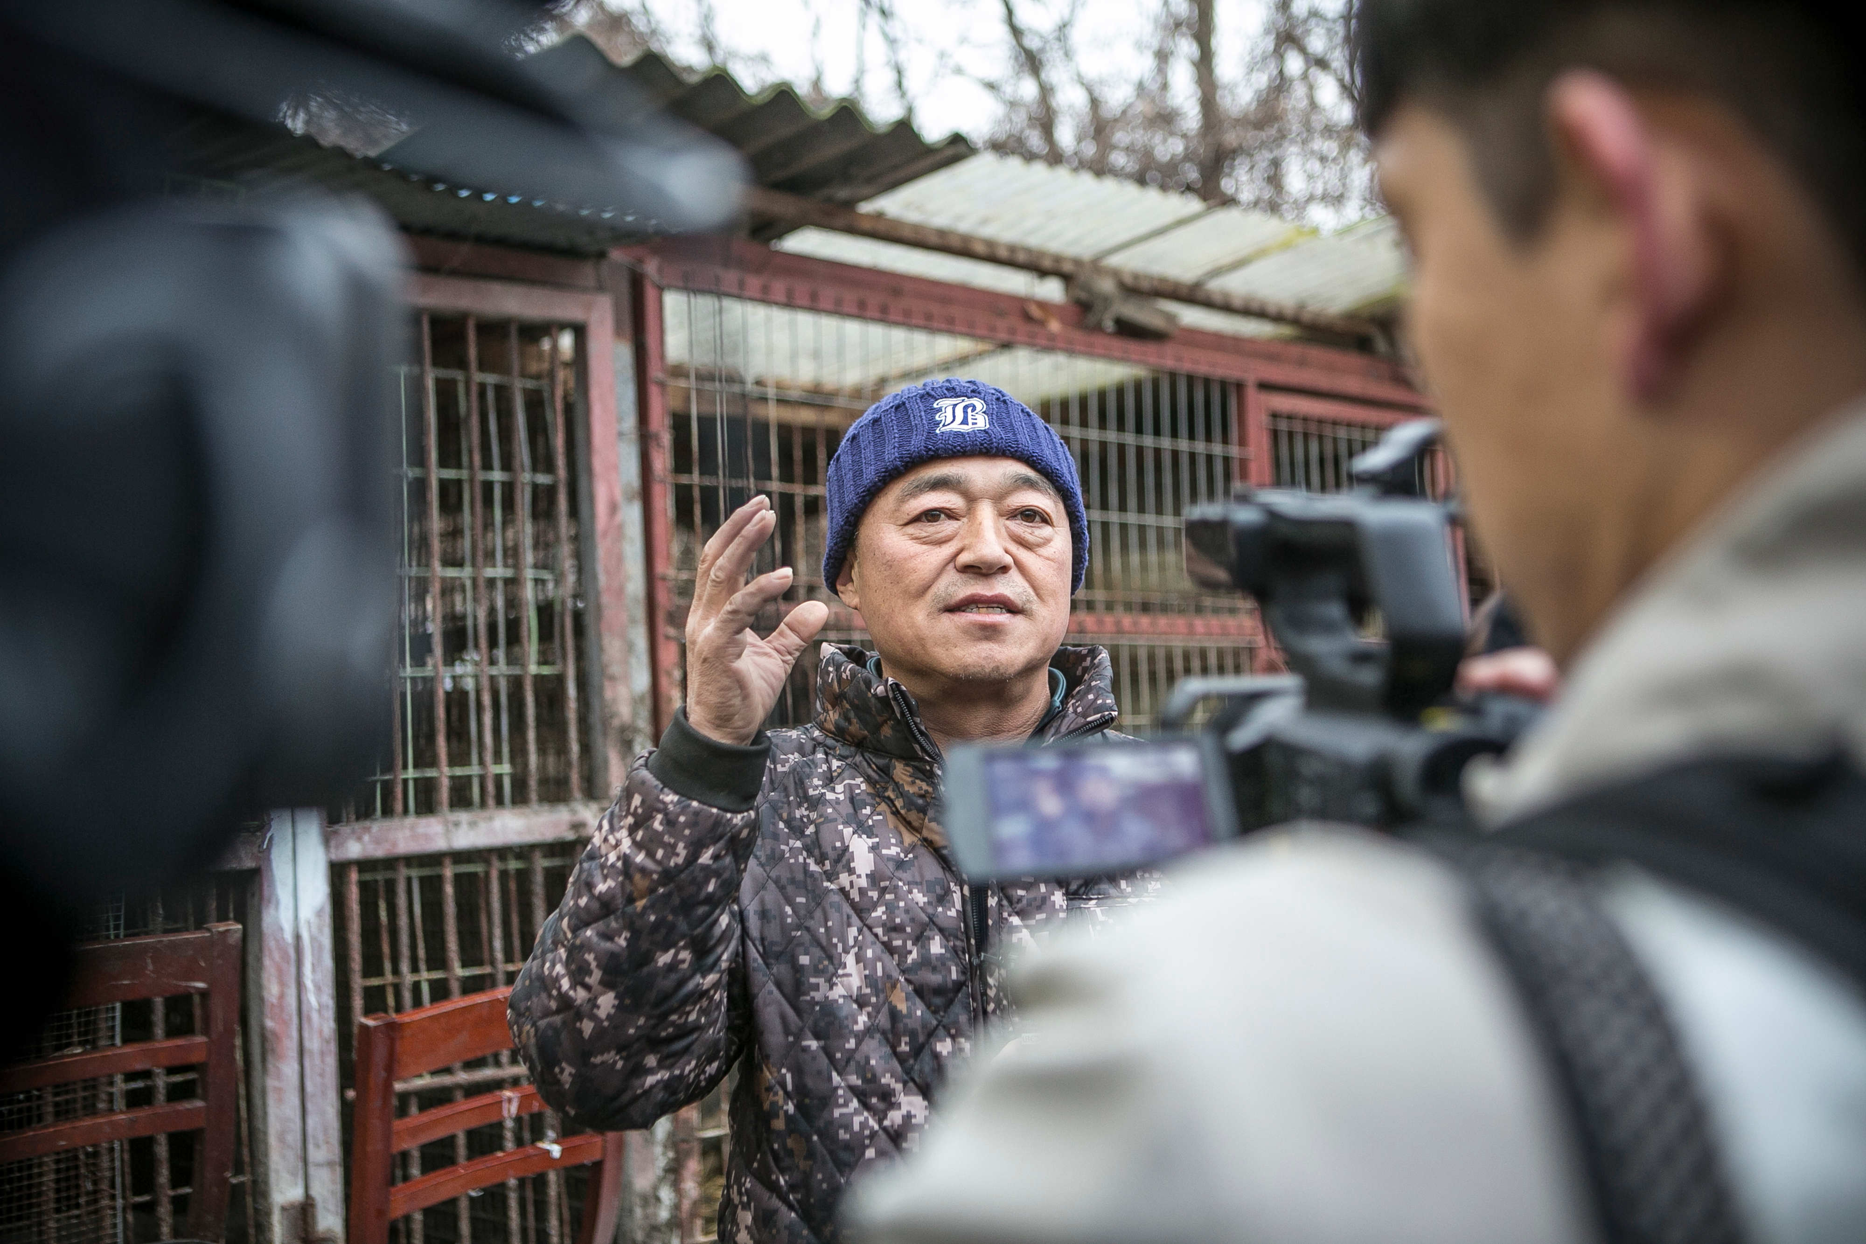
Models for Change
“Lend me your eyes and I’ll change what you see. Lend me your heart and I’ll change how you feel. Lend me your hands and I’ll change what you do.”
8

Slide 9
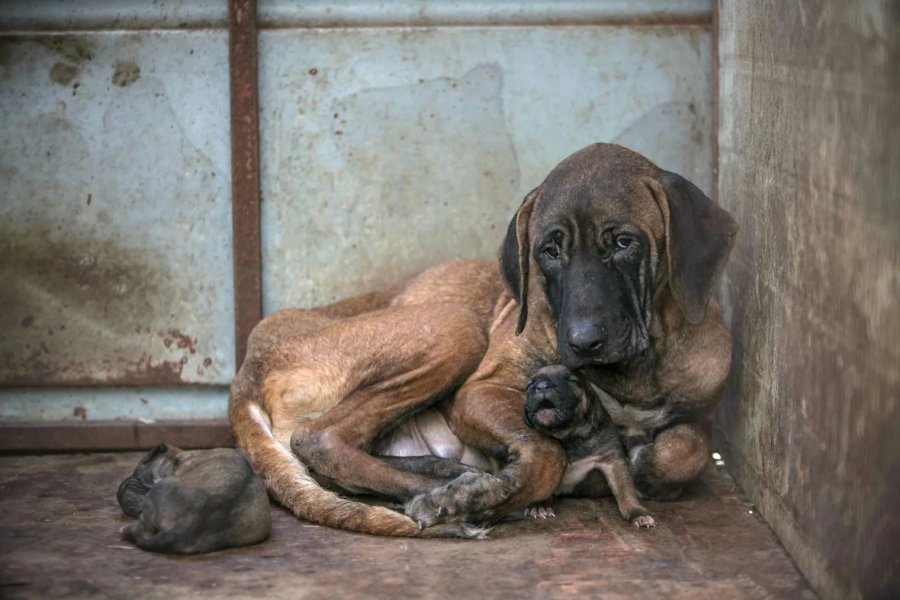
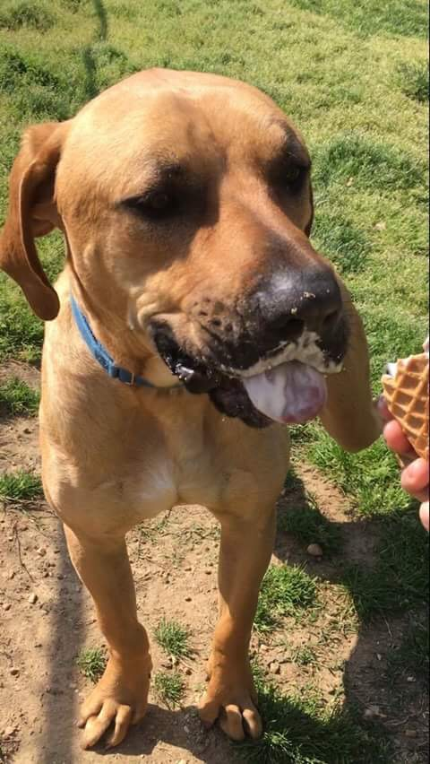
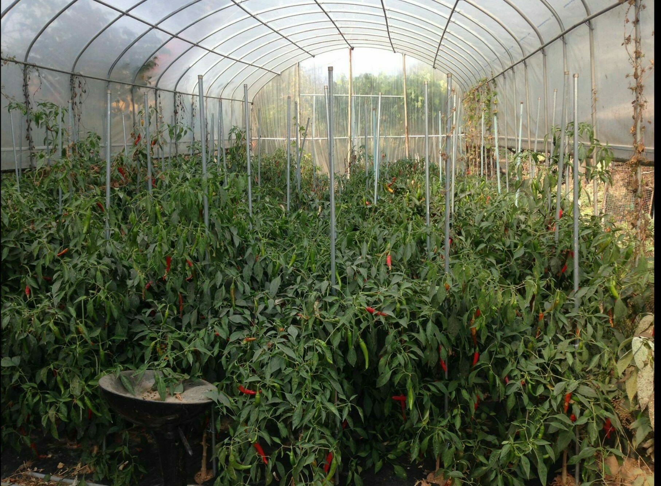
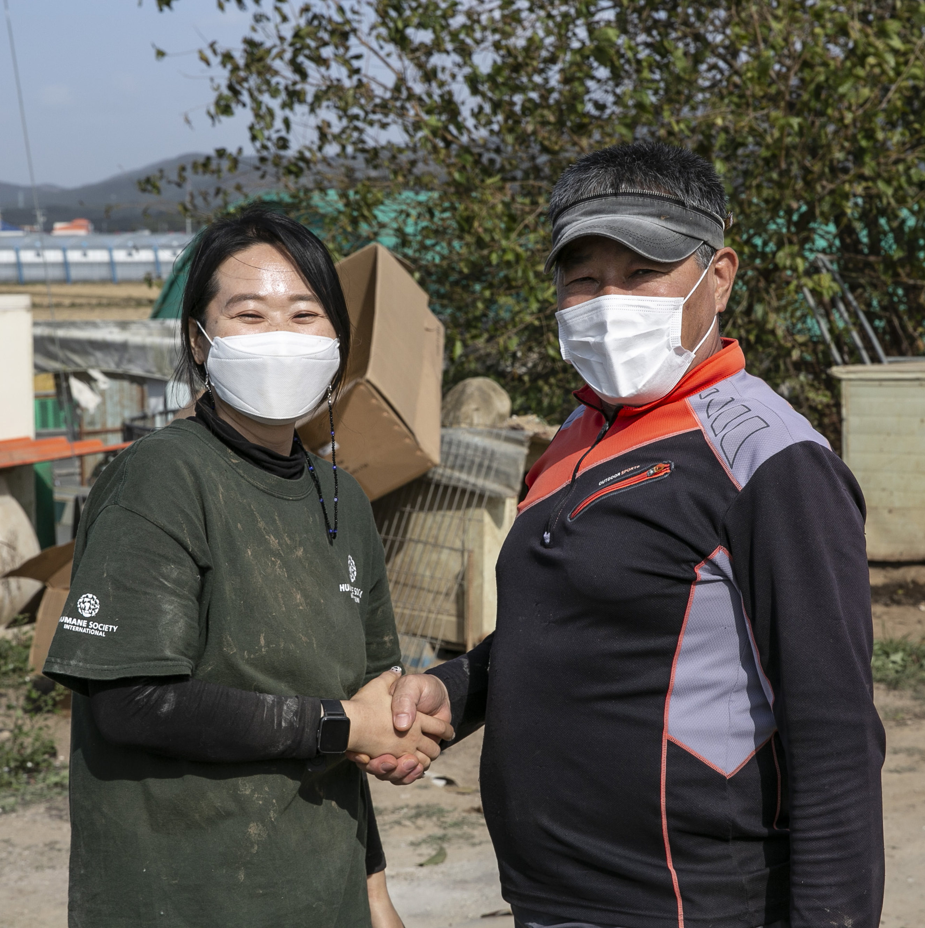
Critical Roles of the Models for Change Program
Showcase our wonderful “Ambassadogs” nationally and internationally to dispel “myths”
Expose reality of the dog meat industry – suffering, unhygienic conditions, all breeds of dogs
End the cycle of suffering and work with farmers to identify and transition into humane, animal-free livelihoods
Increase public support for transition by working with farmers and create blueprint for the government to replicate
9

Slide 10
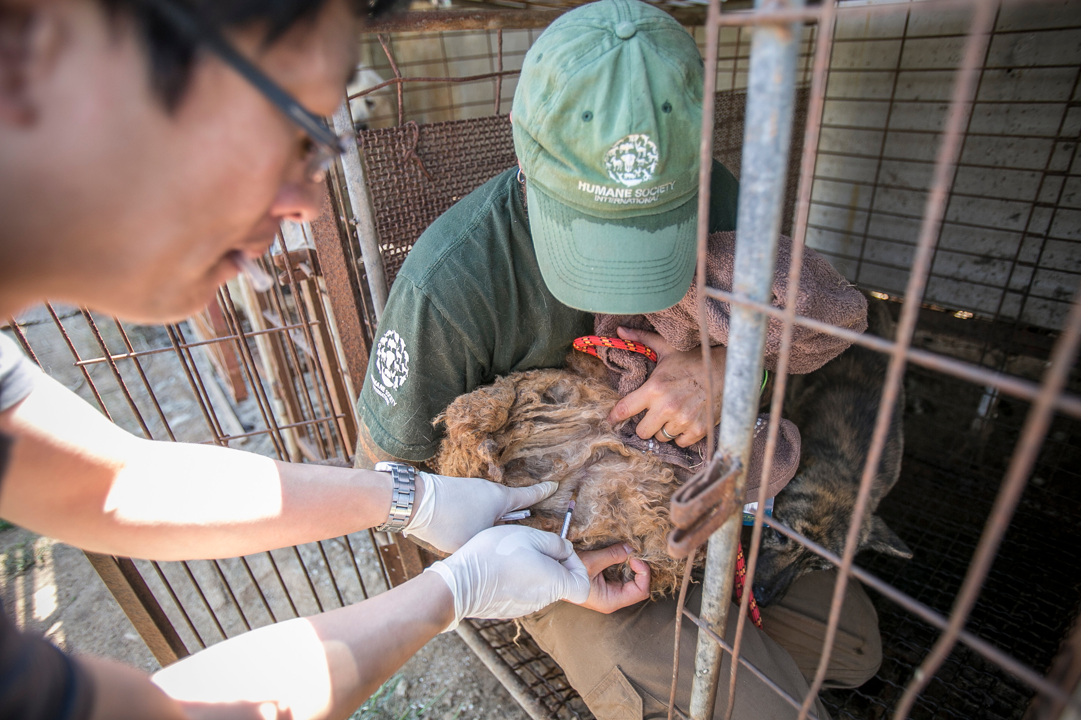
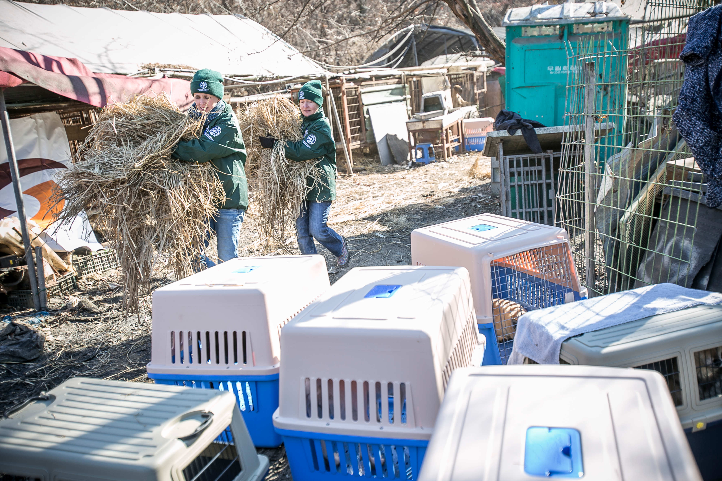
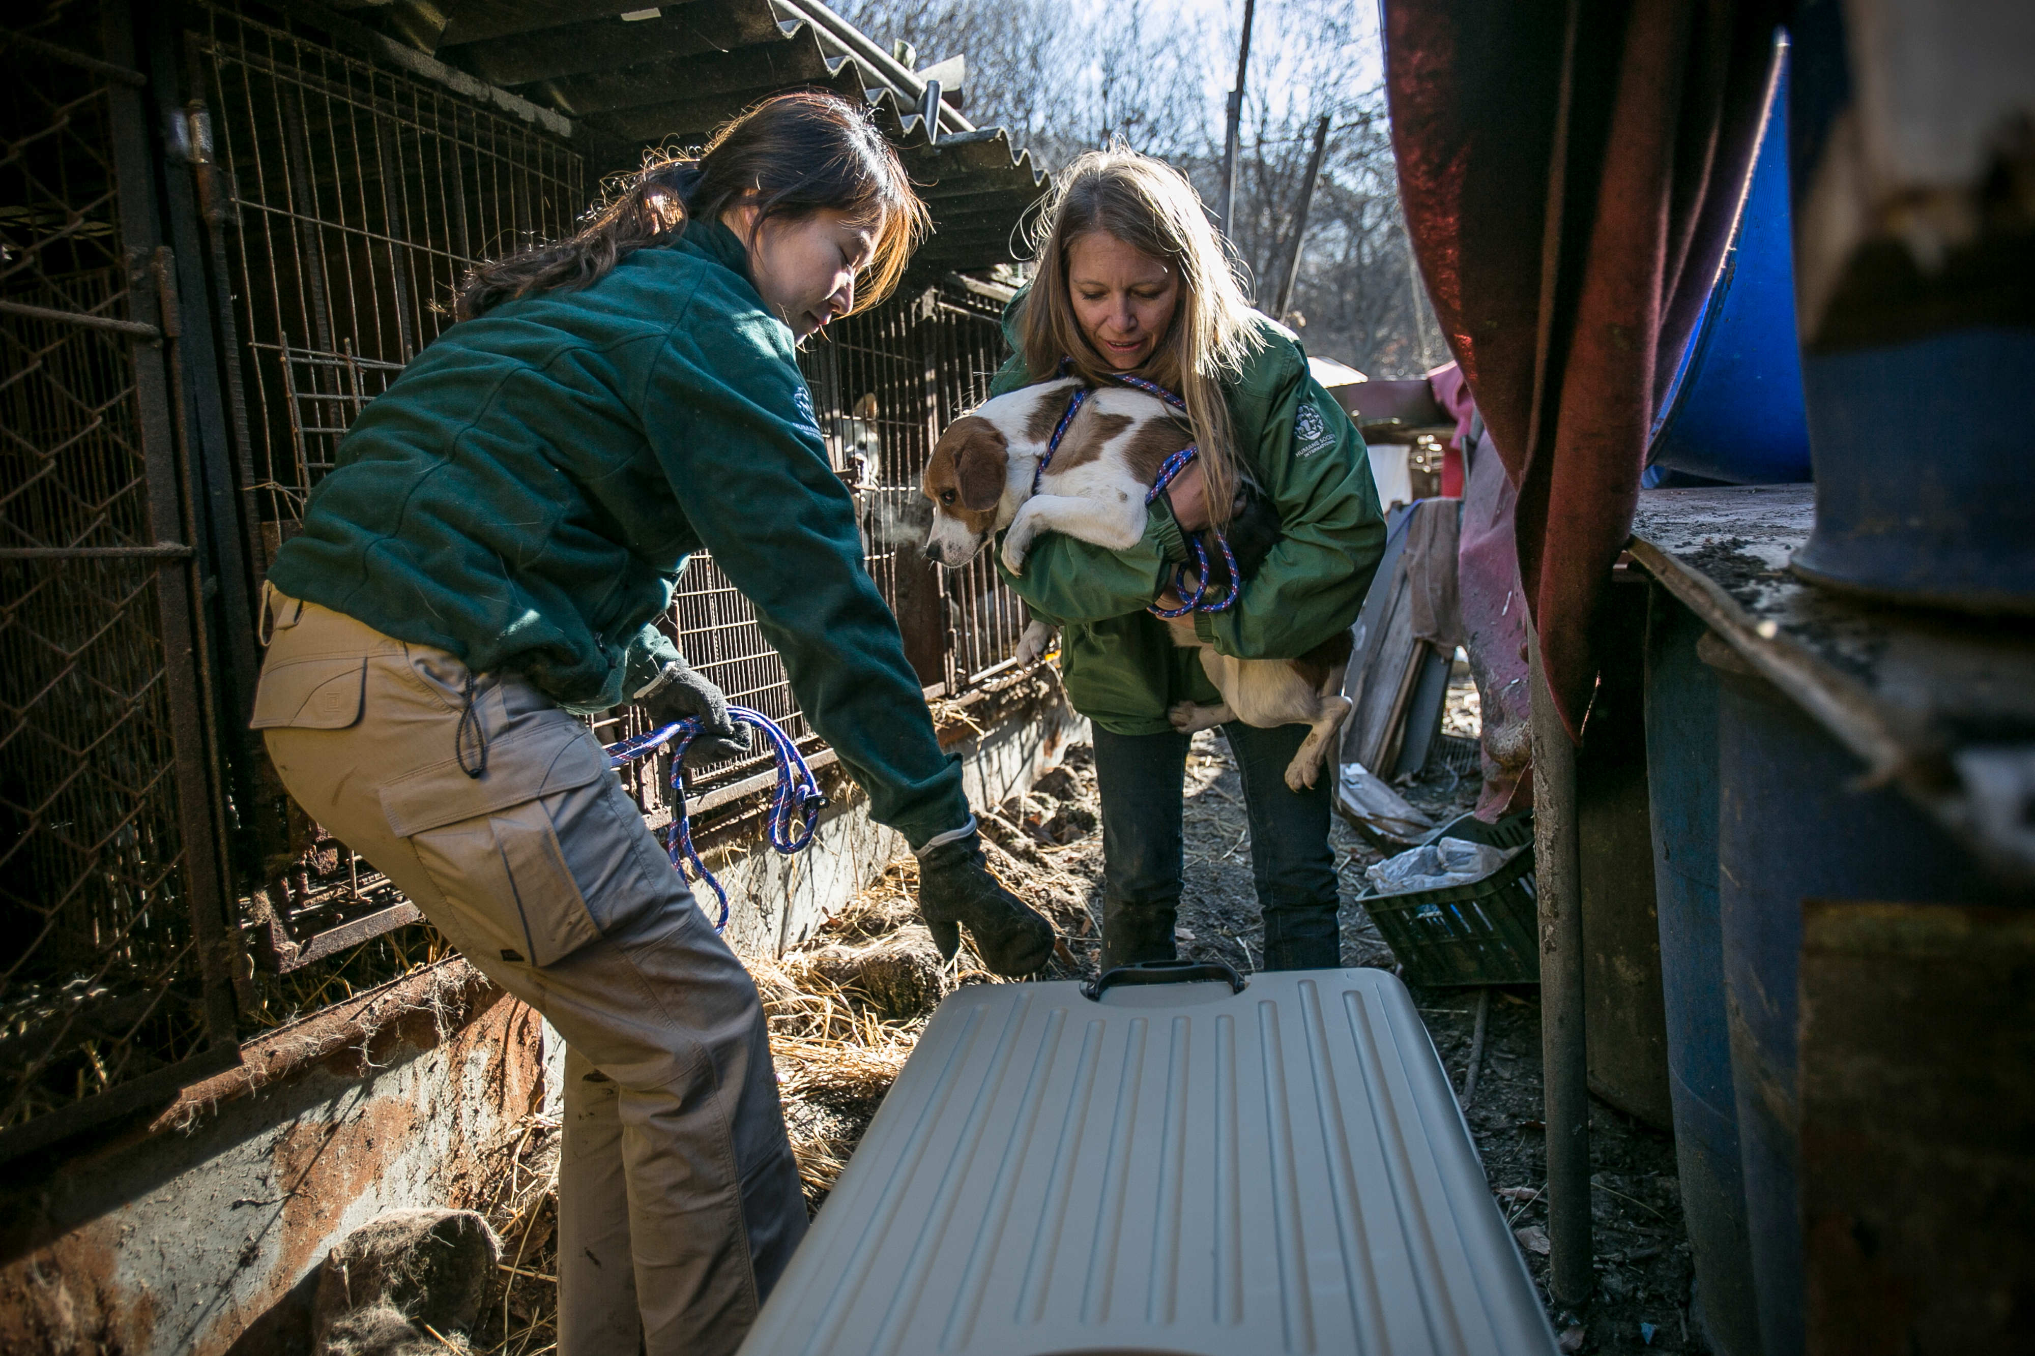
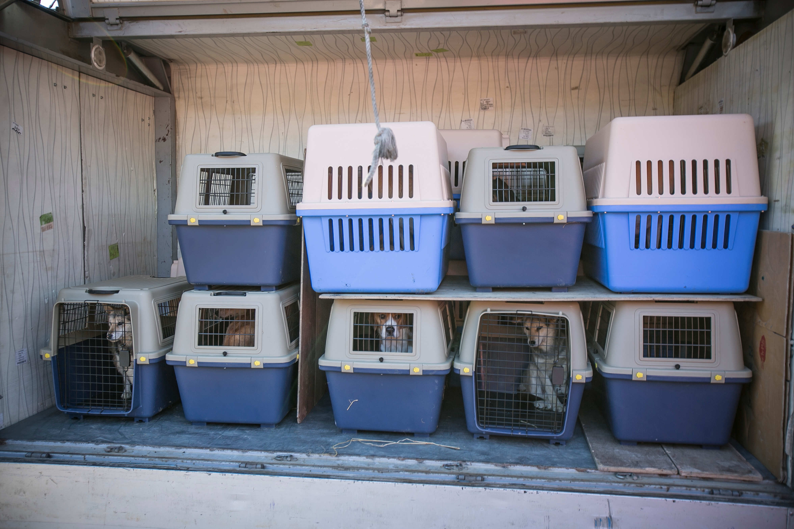
The Process
Identification of a farmer seeking to transition to animal-free alternative livelihood
Preparation of dogs for international rehoming
  Vaccinations
  Quarantining in situ
Removal of all dogs from the farm – media & celebrity engagement and associated public awareness & political lobbying campaigning
  Building social consensus
10

Slide 11
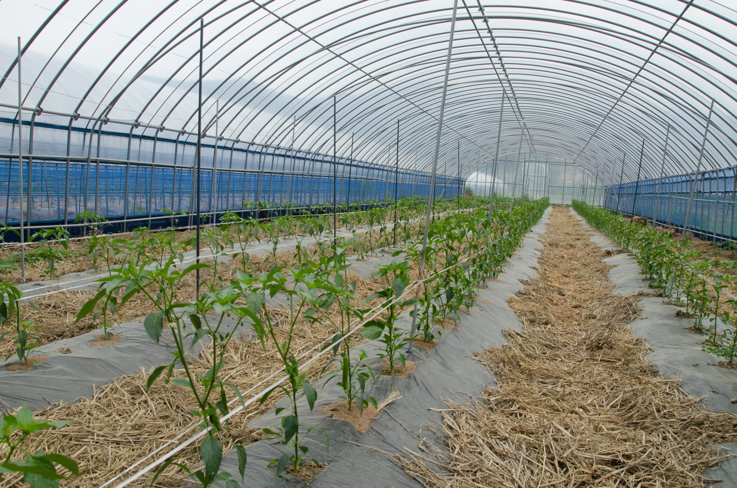
CONFIDENTIAL | For internal use only by the Humane Society family of organizations
11

Slide 12

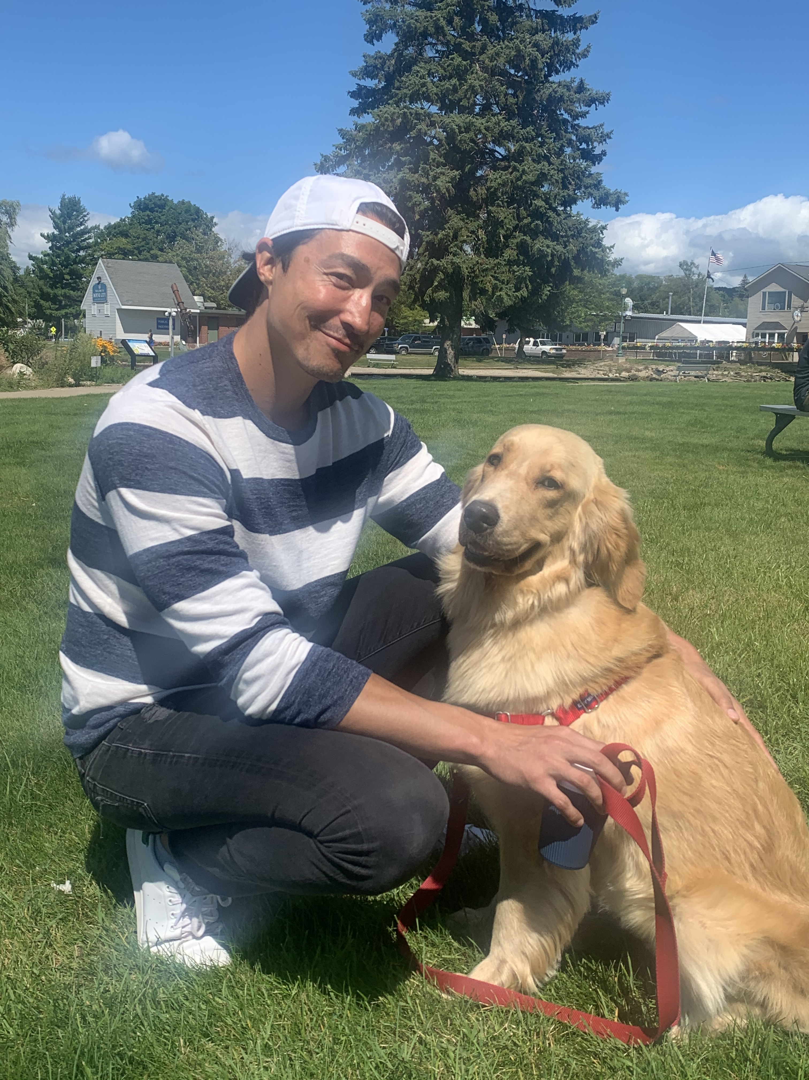
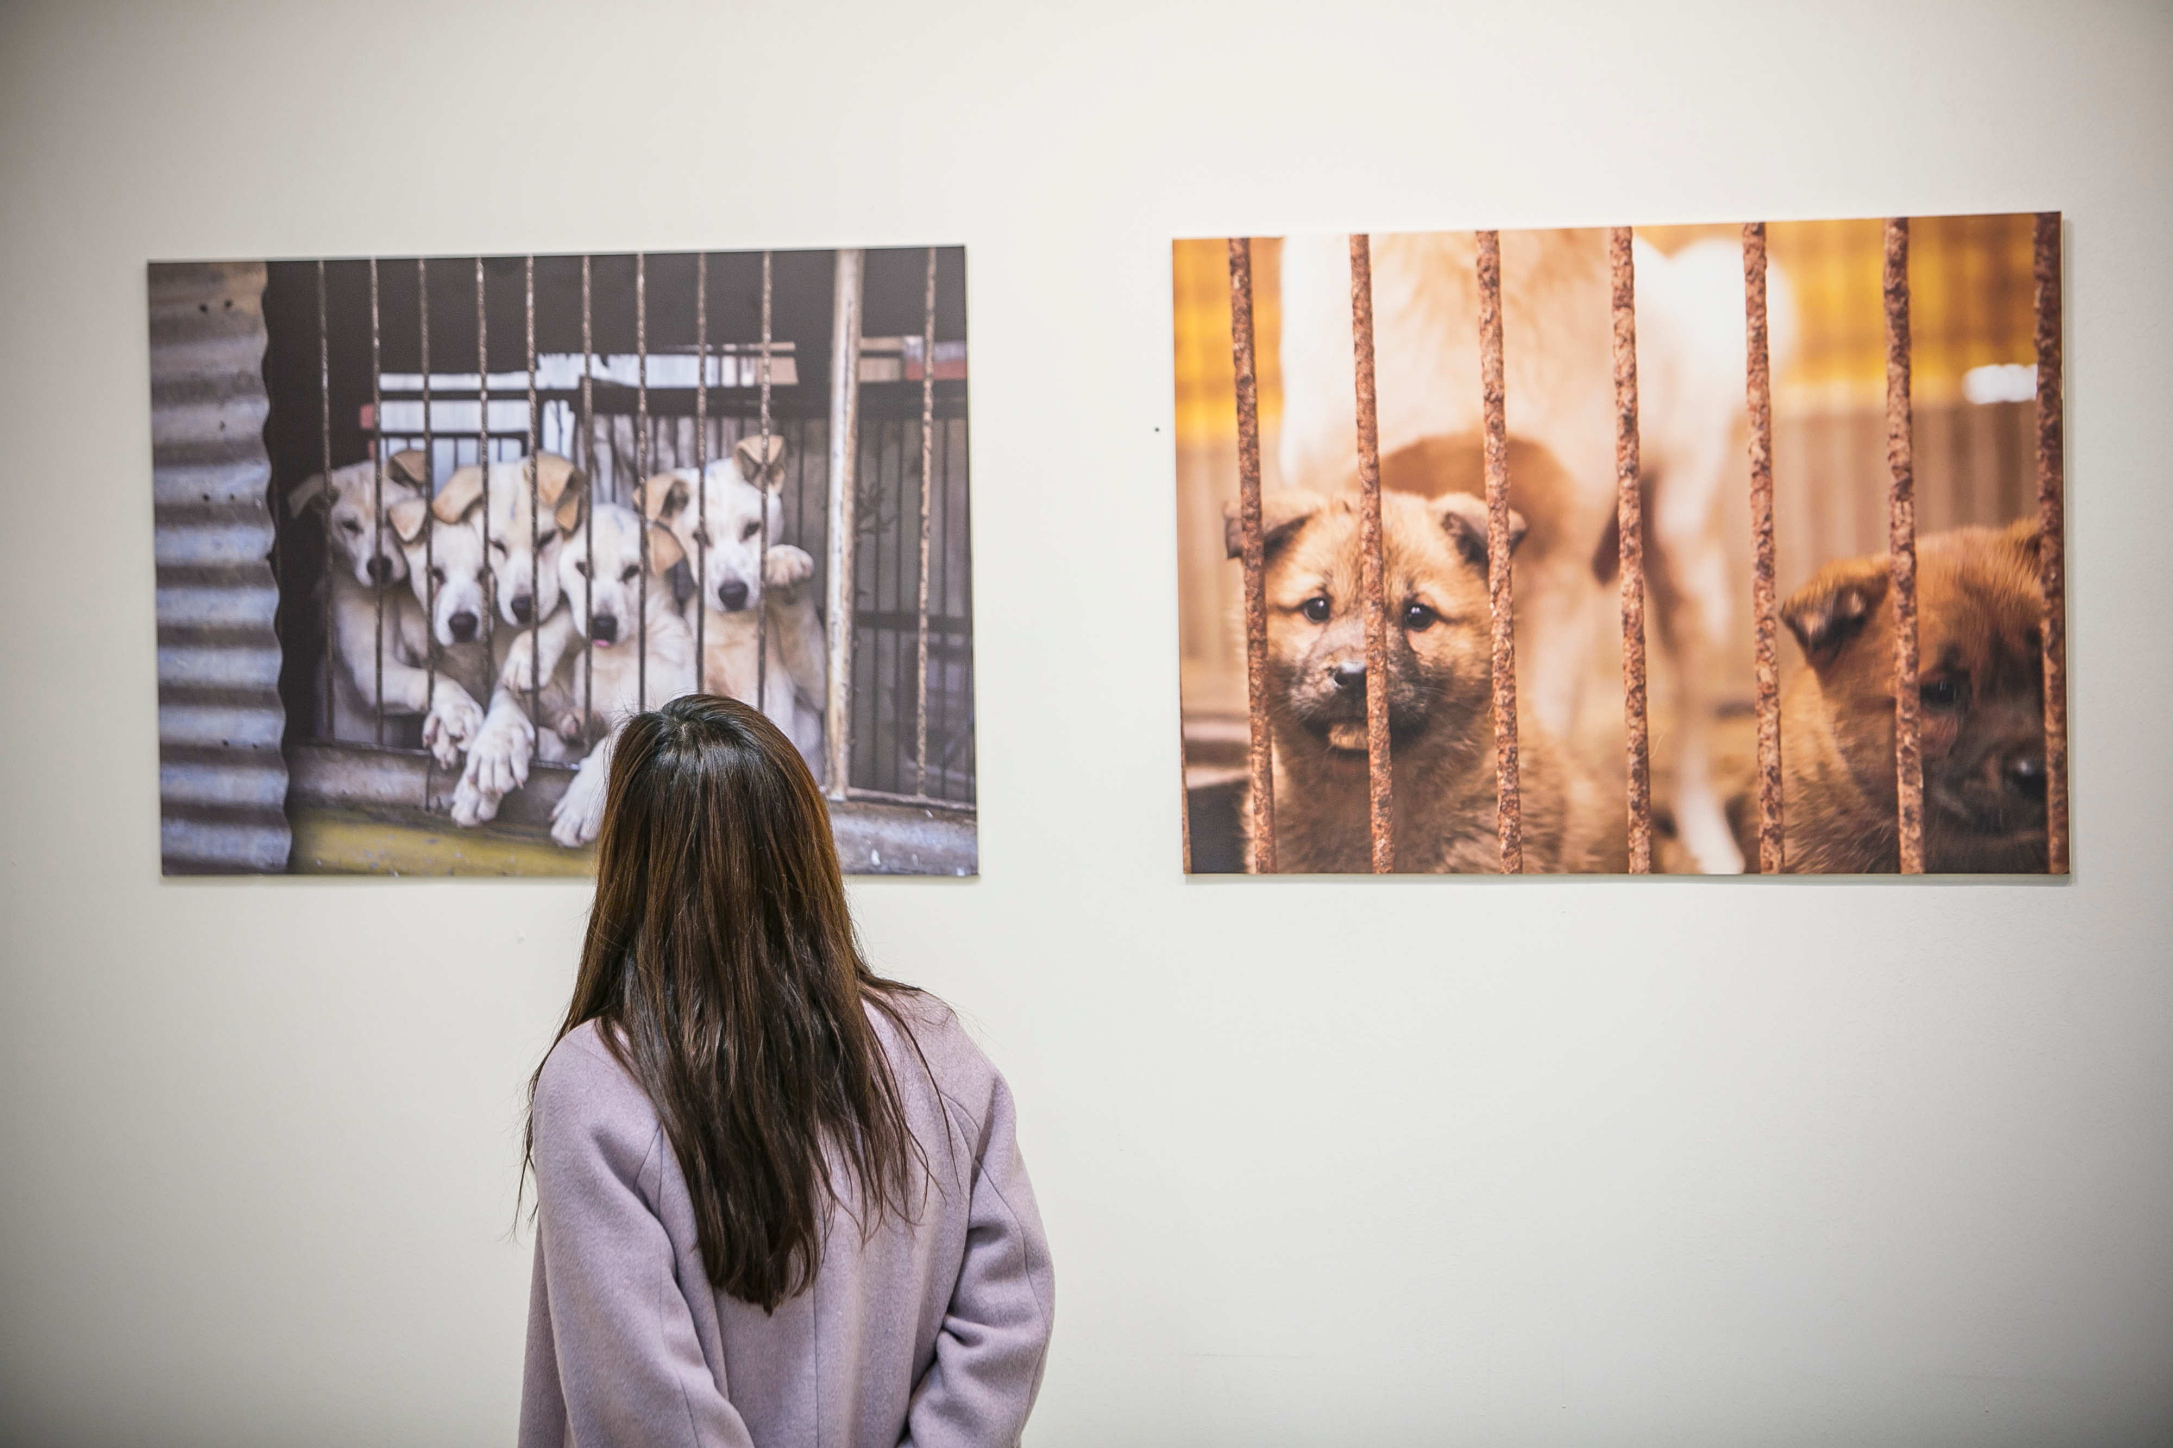
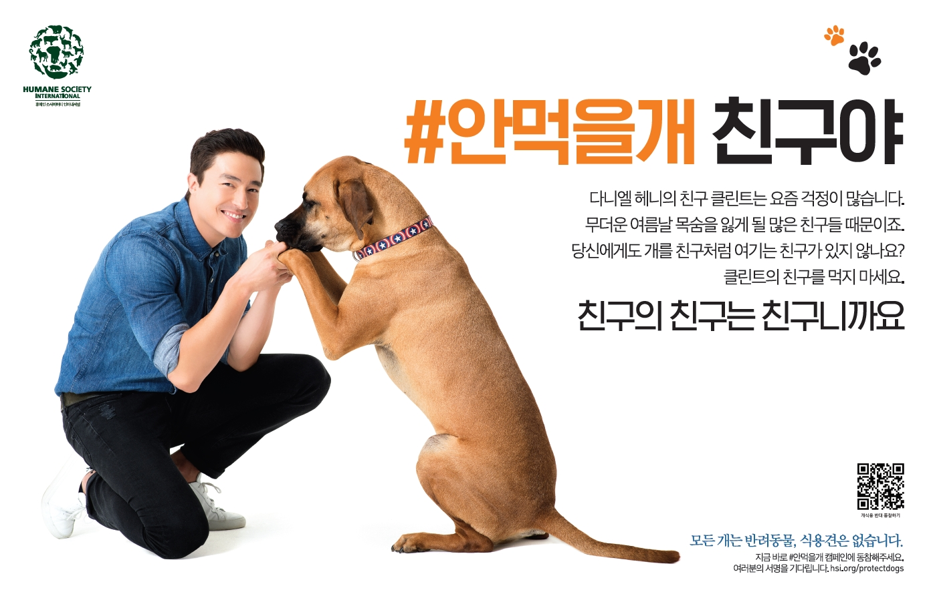
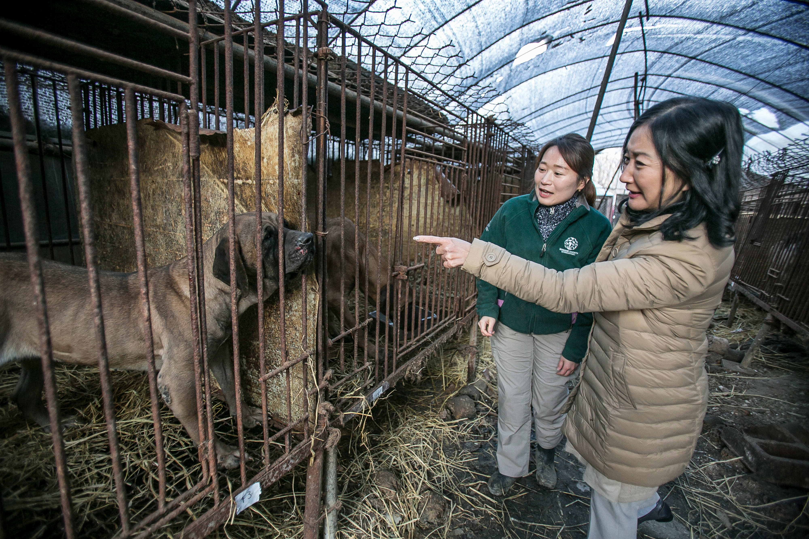

Slide 13
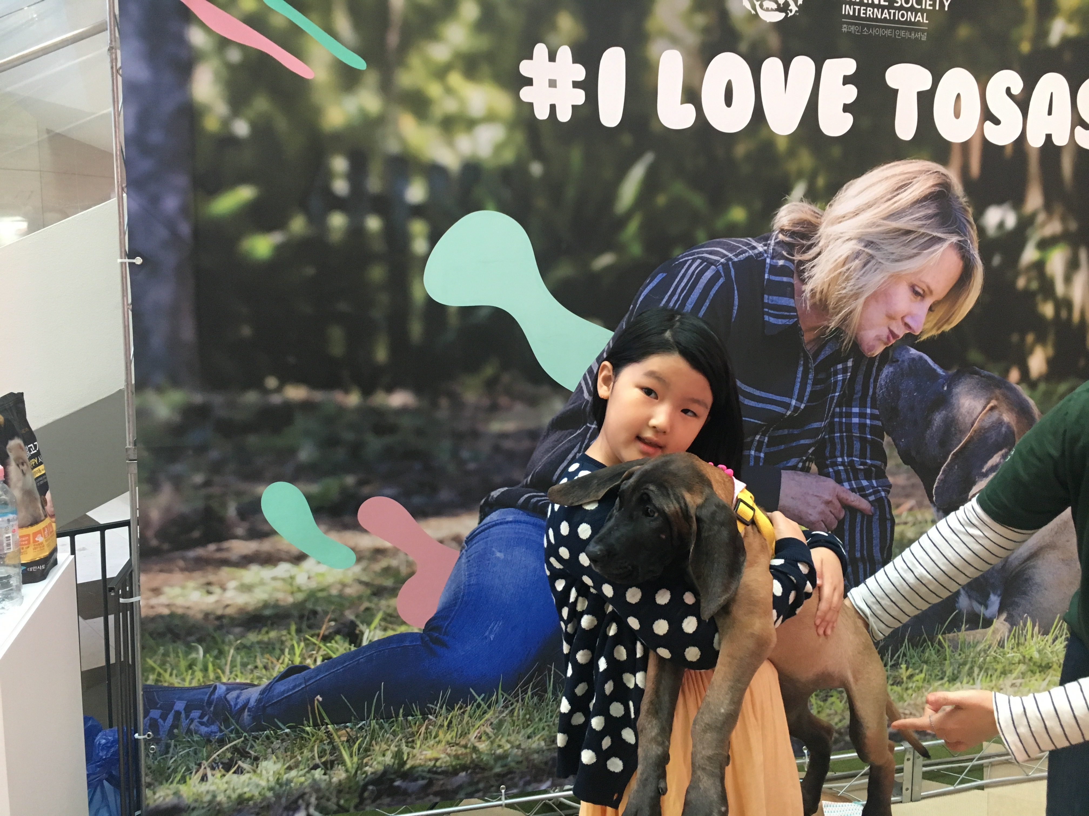
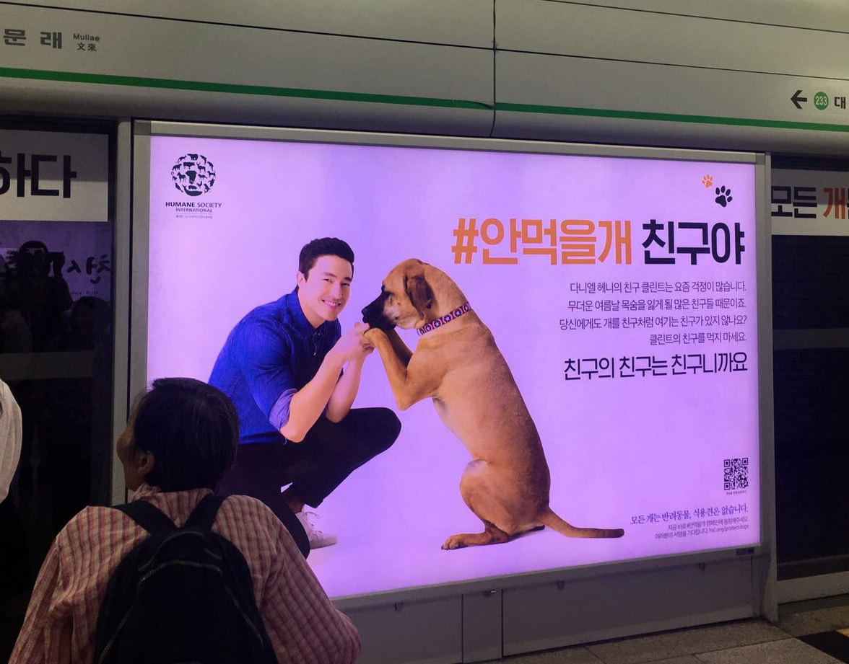


Slide 14
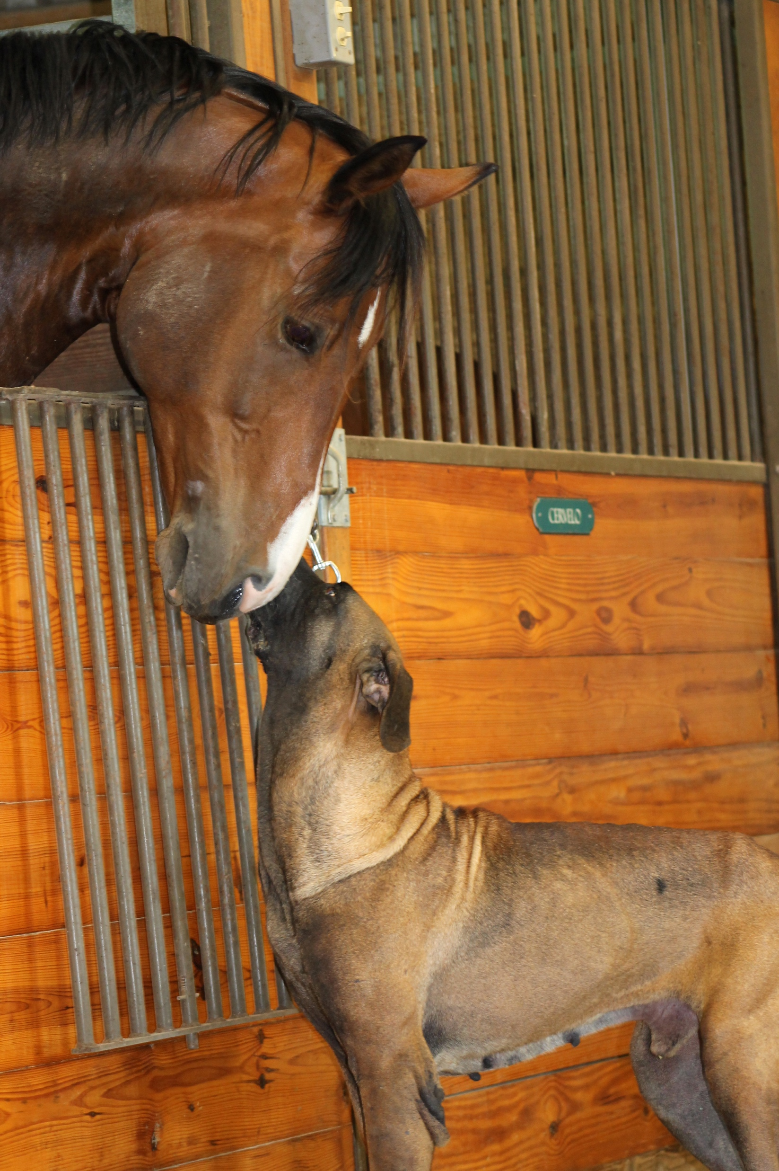
Why International Rehoming?
HSI works with network of partner shelters in the US, Canada and Europe
Behavioural expertise and opportunities
To not add to burden of shelters in-country
More rehoming opportunities
14

Slide 15
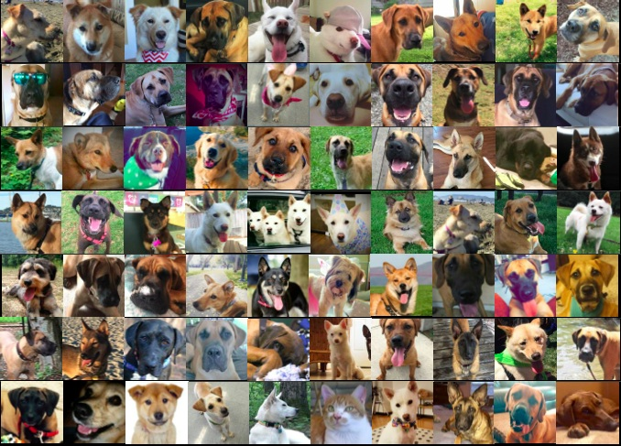
15

Slide 16
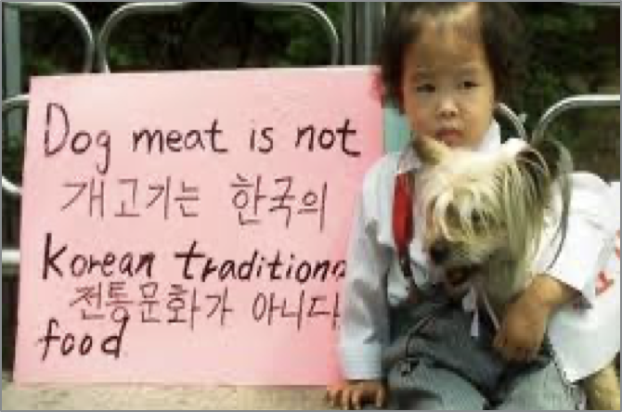
Changing Attitudes
The rate of respondents who support banning dog meat steadily increasing from from 35% in 2017 to 57 % in 2023
A total of 87.8% say never consumed or not willing to in the future (2023).
‘Bosintang’ is no longer a mainstream food consumed over Bok Nal
Est. 5.45 million pet dogs in South Korea in 2022 (from 5.18 million in 2021)

Slide 17
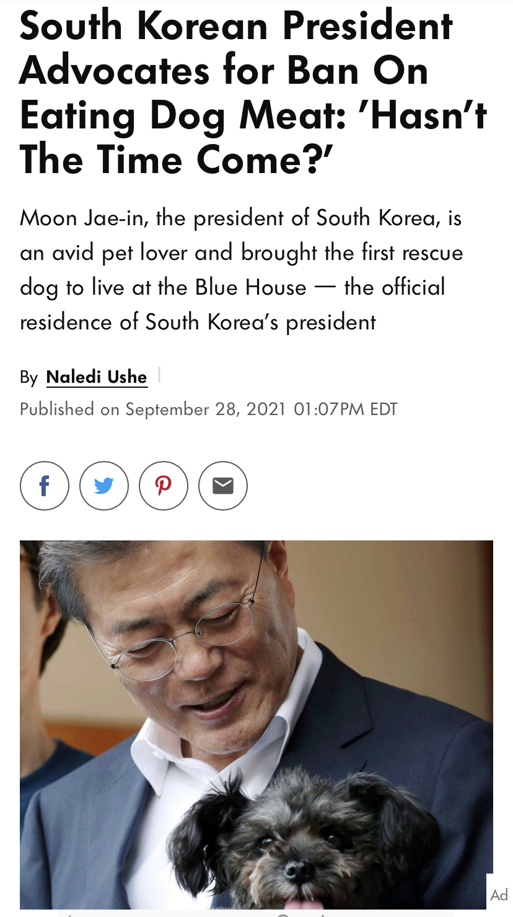
Political Change
Collaborative activities with authorities to closedown markets, slaughterhouses and farms
  Taepyeong slaughterhouse– Nov 2018
  Gupo dog meat market– June 2019
  Illegal dog farm closures – (e.g. Yongin dog farm – April 2021; Jindo Island dog farm – August 2021)
Frequent amendments to national APA to catch up with changing status/ role of dogs in society
Catalyst for change: September 2021: President Moon: “Has the time not come?”
17

Slide 18
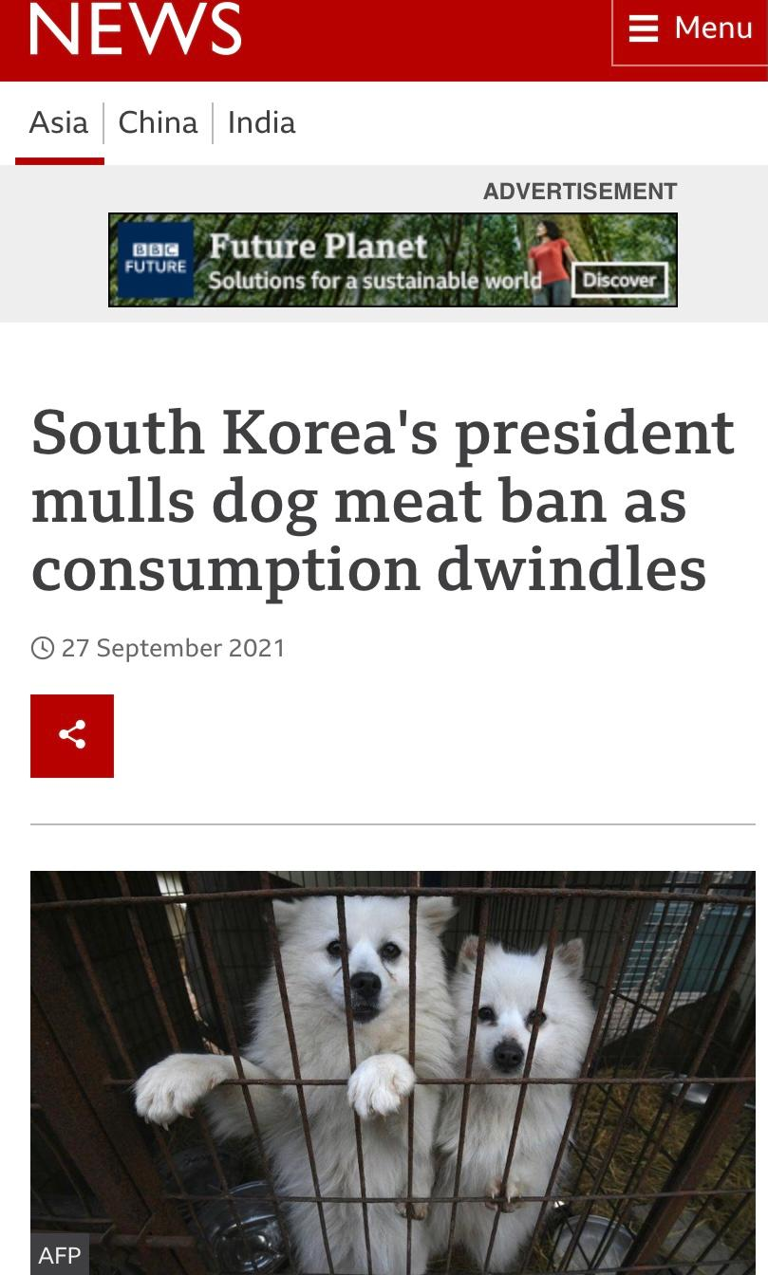
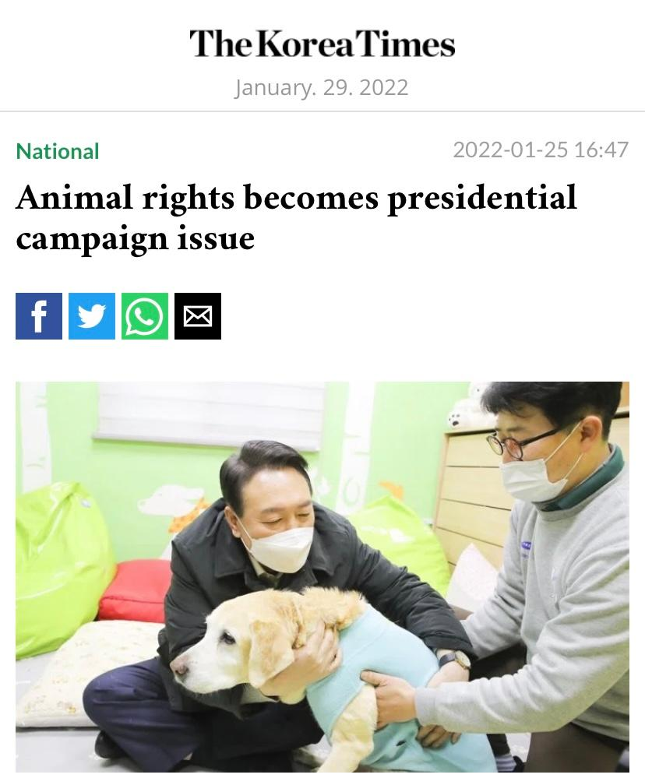
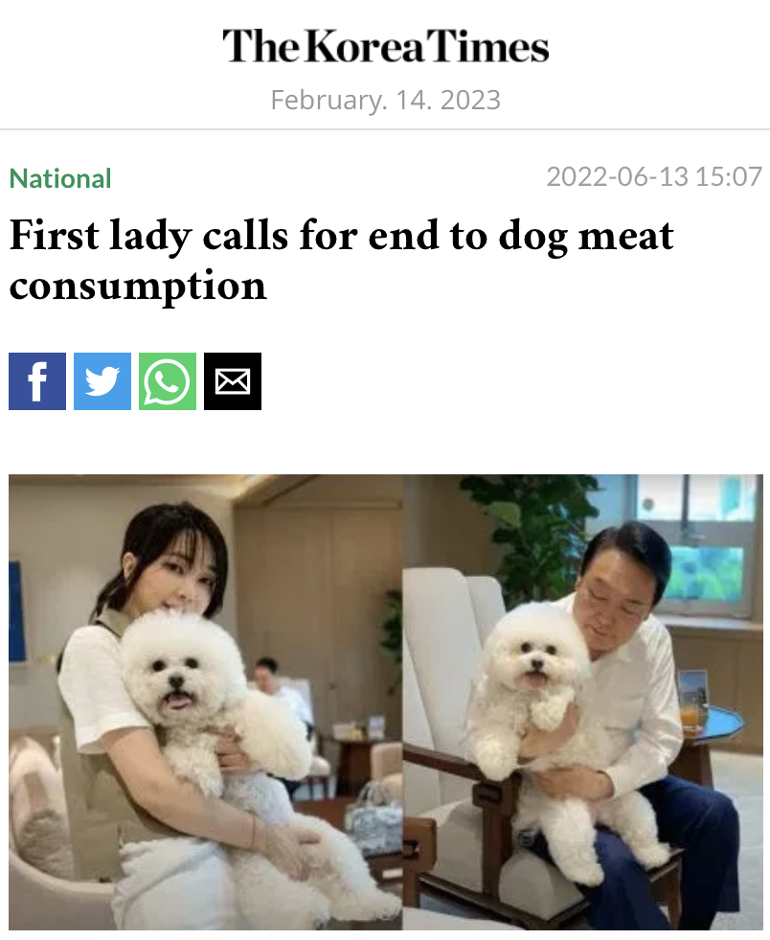
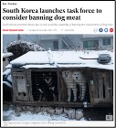
Political Change
December 2021: Cross-Ministerial Task Force creation
2021/ 2022: Presidential candidate manifestos
Proposed legislative bans – Congresswoman Han (December 2020/ 2023)
First Lady speaks out (2023)
May 2023: Seoul reconsiders banning dog meat consumption
18

Slide 19
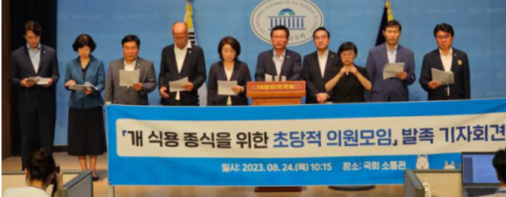
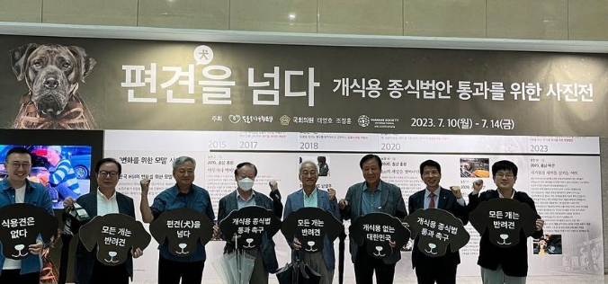
Political Change
Now, all major political parties have introduced bills to phase out and end the dog meat industry (5 in total)!
24th August, Assembly Resolution
  44 lawmakers – spanning ruling and opposition parties – officially announced the Assembly Resolution endorsing a dog meat ban and pledging to advance a bill to END the dog meat industry nationwide!
17th December: MAFRA introduced Special Act with associated Roadmap to end dog meat industry withing 3 year phase out/ grace period ( end in 2027)
19

Slide 20
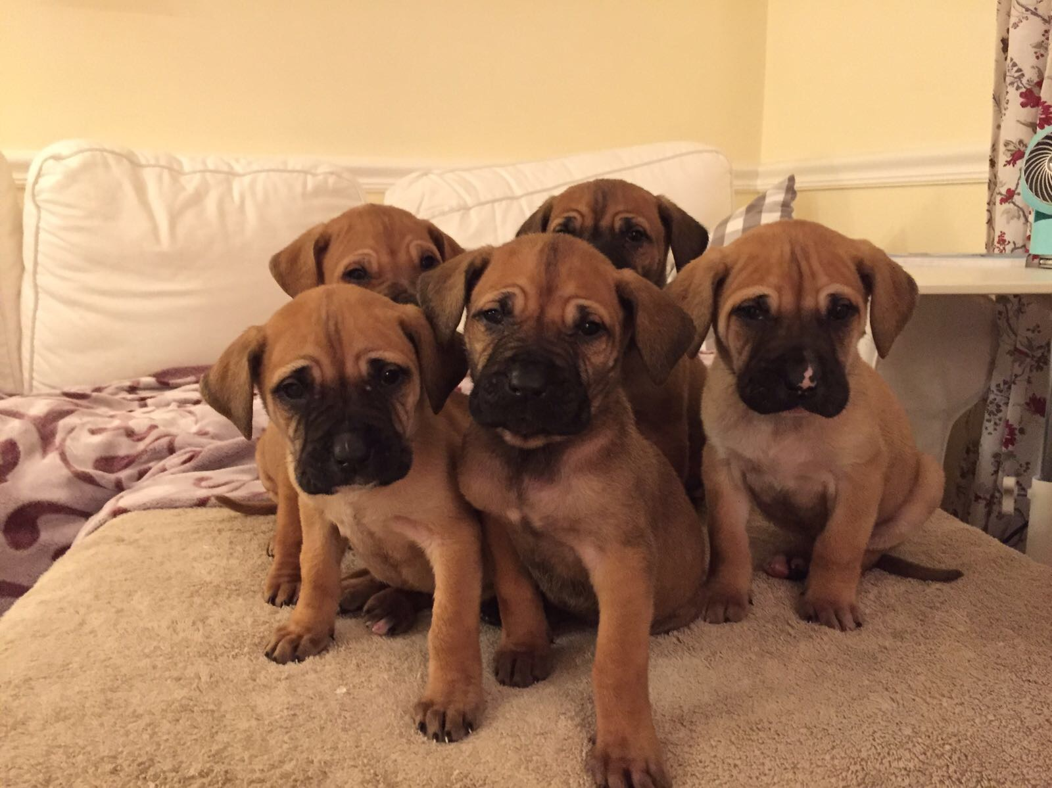
Thank you ~

