Slide 1
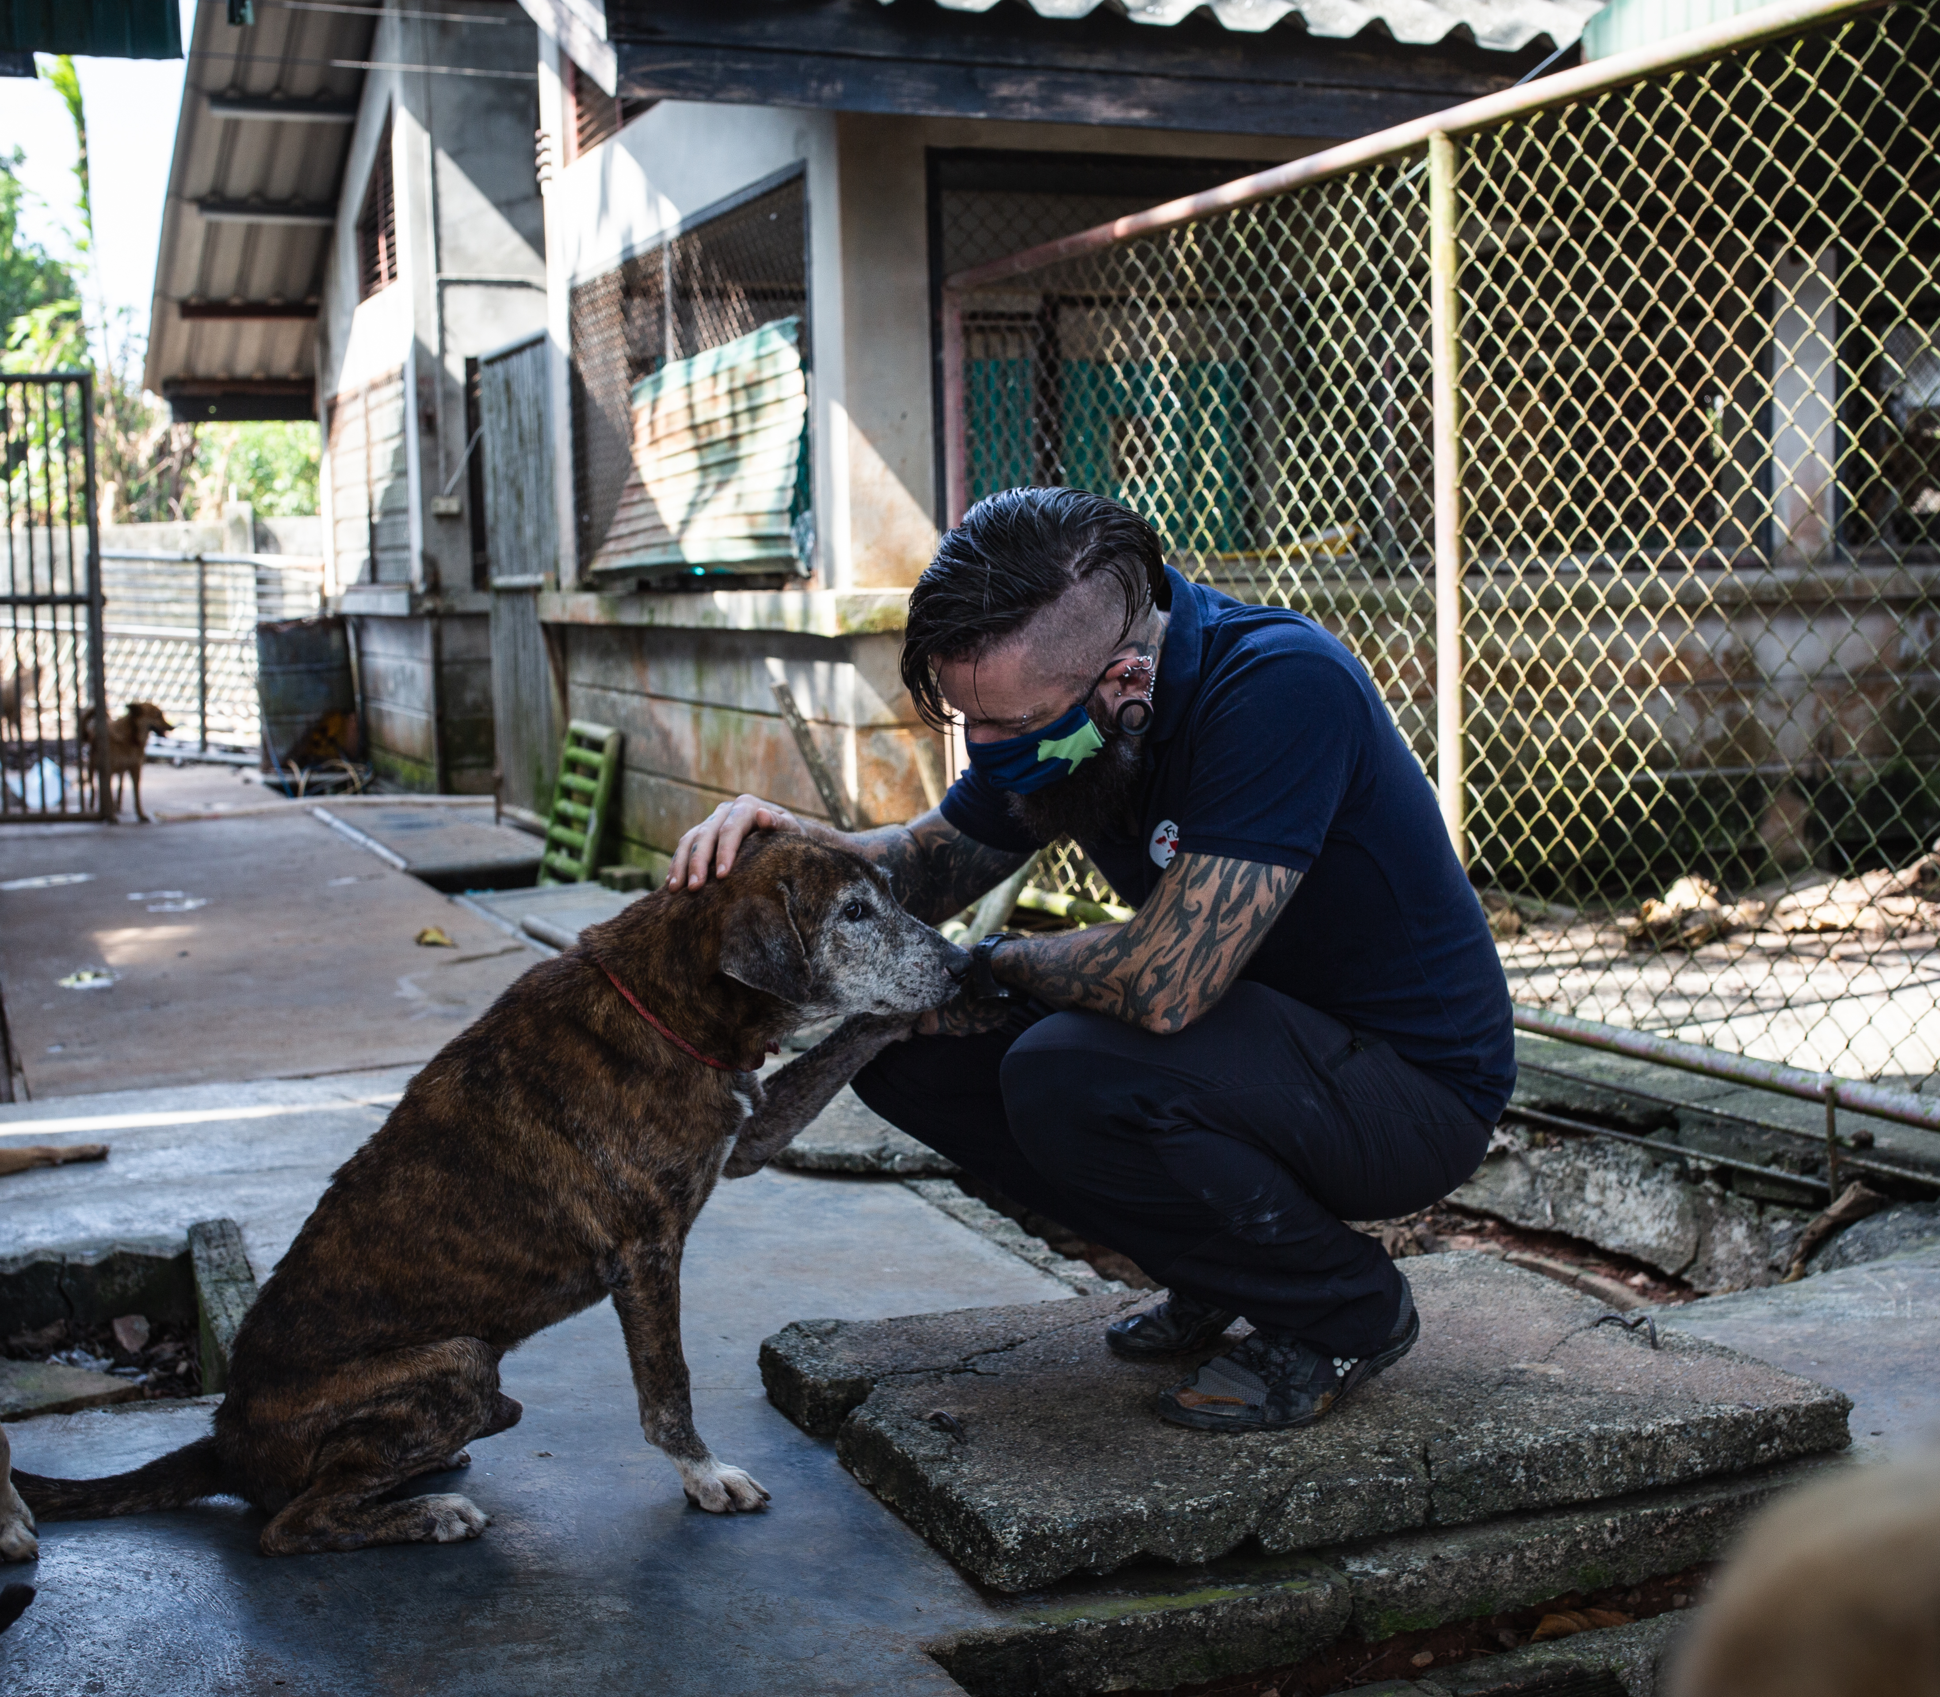
Understanding compassion fatigue – supporting good mental health in animal welfare professionals
Matt Backhouse
Head of Stray Animal Care Southeast Asia
Bogor City, December 7^{th,} 2023.
© FOUR PAWS | Lanta Animal Welfare

Slide 2



Definitions and key terms
Sympathy means you understand what the other person or animal is feeling and you might feel sorry for them.
Empathy means you actually feel what the other person or animal is feeling.
Compassion is the willingness to take action to relieve that suffering.

Slide 3

What is compassion fatigue?
Empathetic distress / Secondary trauma syndrome
Defined as a gradual reduction of compassion over time, because of direct or indirect exposure to trauma
Prevalent in jobs that deal with difficult and traumatic situations (animal rescue, nurses, firefighters etc)
"The expectation that we can be immersed in suffering and loss daily and not be touched by it is as unrealistic as expecting to be able to walk through water without getting wet.“
Question: Is this the same as ‘burnout’?
Notes:
Another way of understanding it is that it's the profound emotional, physical, social, mental, and spiritual depletion that causes a decline in our desire, our energy, and our ability to feel and behave in a caring way towards others.
This arises from this constant demand to be both compassionate and effective in helping those in need.

Slide 4
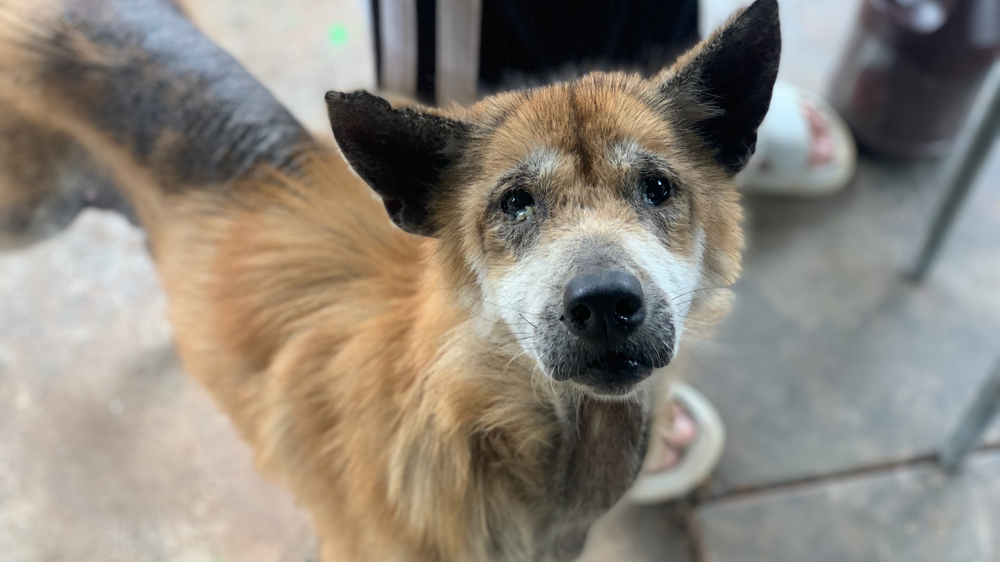
Title of the slide max 2 lines
© FOUR PAWS | Lanta Animal Welfare

Slide 5

Signs and symptoms
Anger
Frustration
Irritability
Sadness
Negativity
Guilt / shame
Feeling inadequate
Reduced empathy
Resentment
Dark humour / sarcasm
Forgetfulness
Feeling overwhelmed
Numb to violence
Poor decision making
Reduced sex drive
Abusing substances
Poor work / life balance
Poor relationships
Seeing yourself as indispensable

Slide 6

Personal solutions
Be honest with yourself – identify thoughts and feelings as they come up, without judgement
Share how you feel with someone you trust
Be kind to yourself (and others). Do things that bring you joy!
Educate yourself – resources available after this presentation

Slide 7
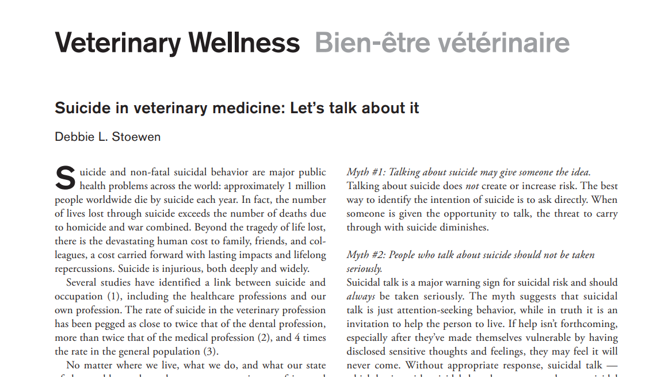
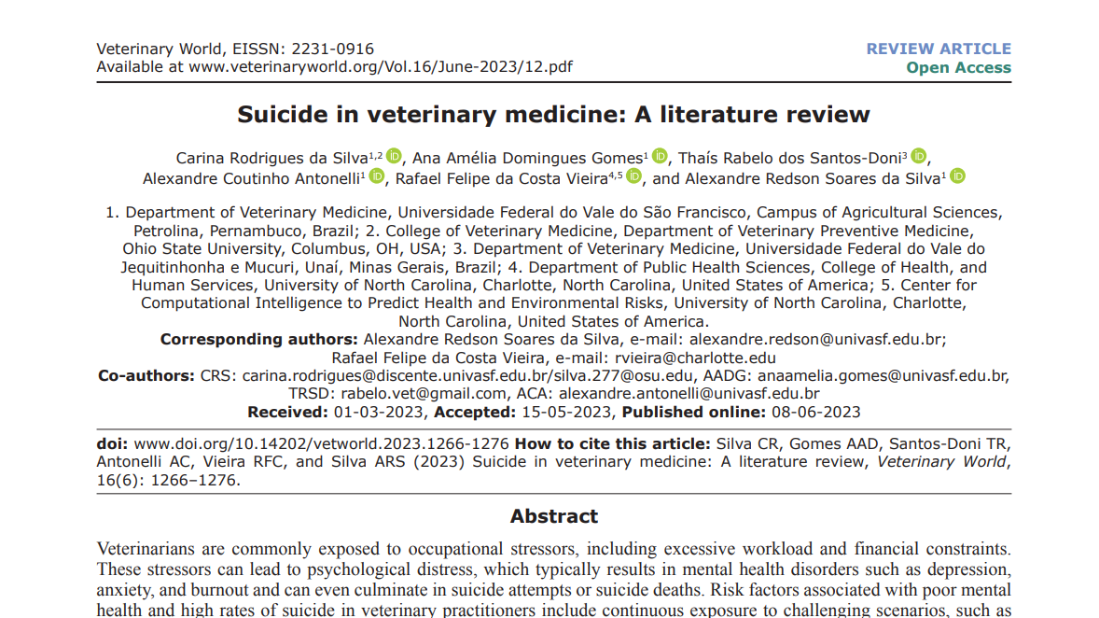
Suicide in veterinary professionals
https://www.veterinaryworld.org/Vol.16/June-2023/12.pdf
https://www.ncbi.nlm.nih.gov/pmc/articles/PMC4266064/pdf/cvj_01_89.pdf
https://www.ncbi.nlm.nih.gov/pmc/articles/PMC7764342/pdf/ijerph-17-09196.pdf

Slide 8

Resources and support
Not One More Vet: https://www.nomv.org
Open Counselling: https://blog.opencounseling.com/hotlines-id/
Bisa Helpline:
https://bisahelpline.org/

Slide 9

employer solutions
Provide training and information about CF
Reduce stress in the workplace (or at home)
Have a support system for employees
Respect privacy outside working hours
Be open to feedback and listen to what employees have to say

Slide 10
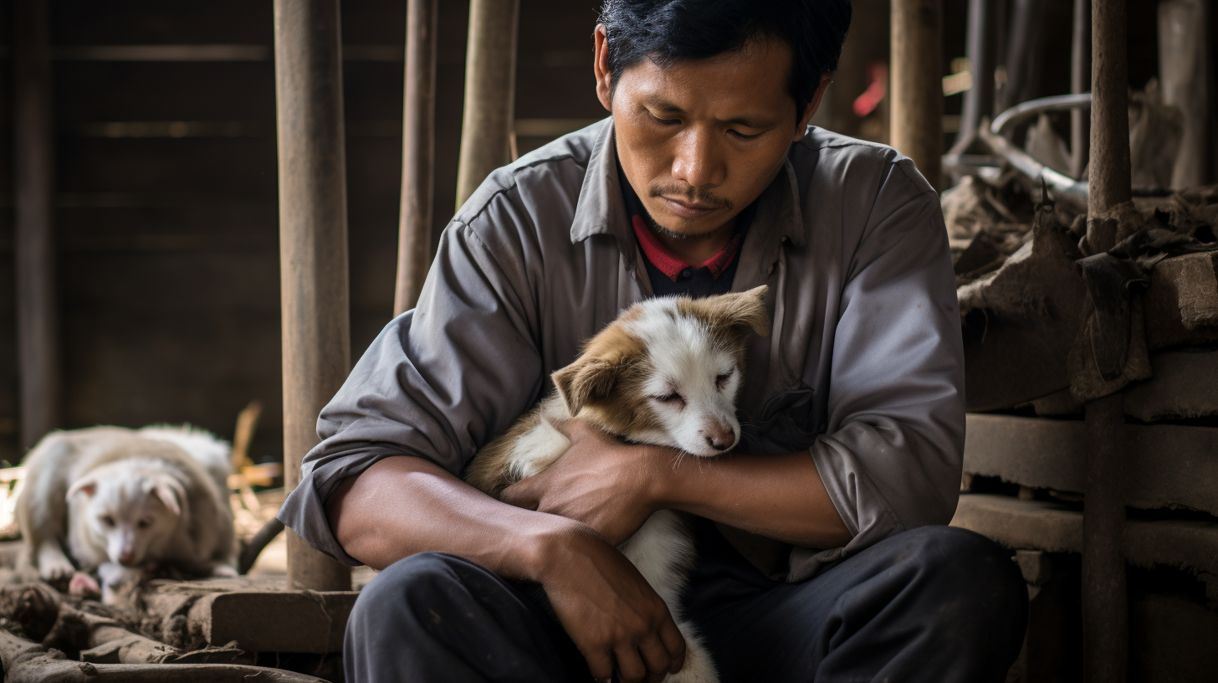
You have power over your mind – not outside events. Realize this, and you will find strength.
You are enough.
You are loved.
You matter.
Always.
Section dIvider
  Additional information

Slide 11
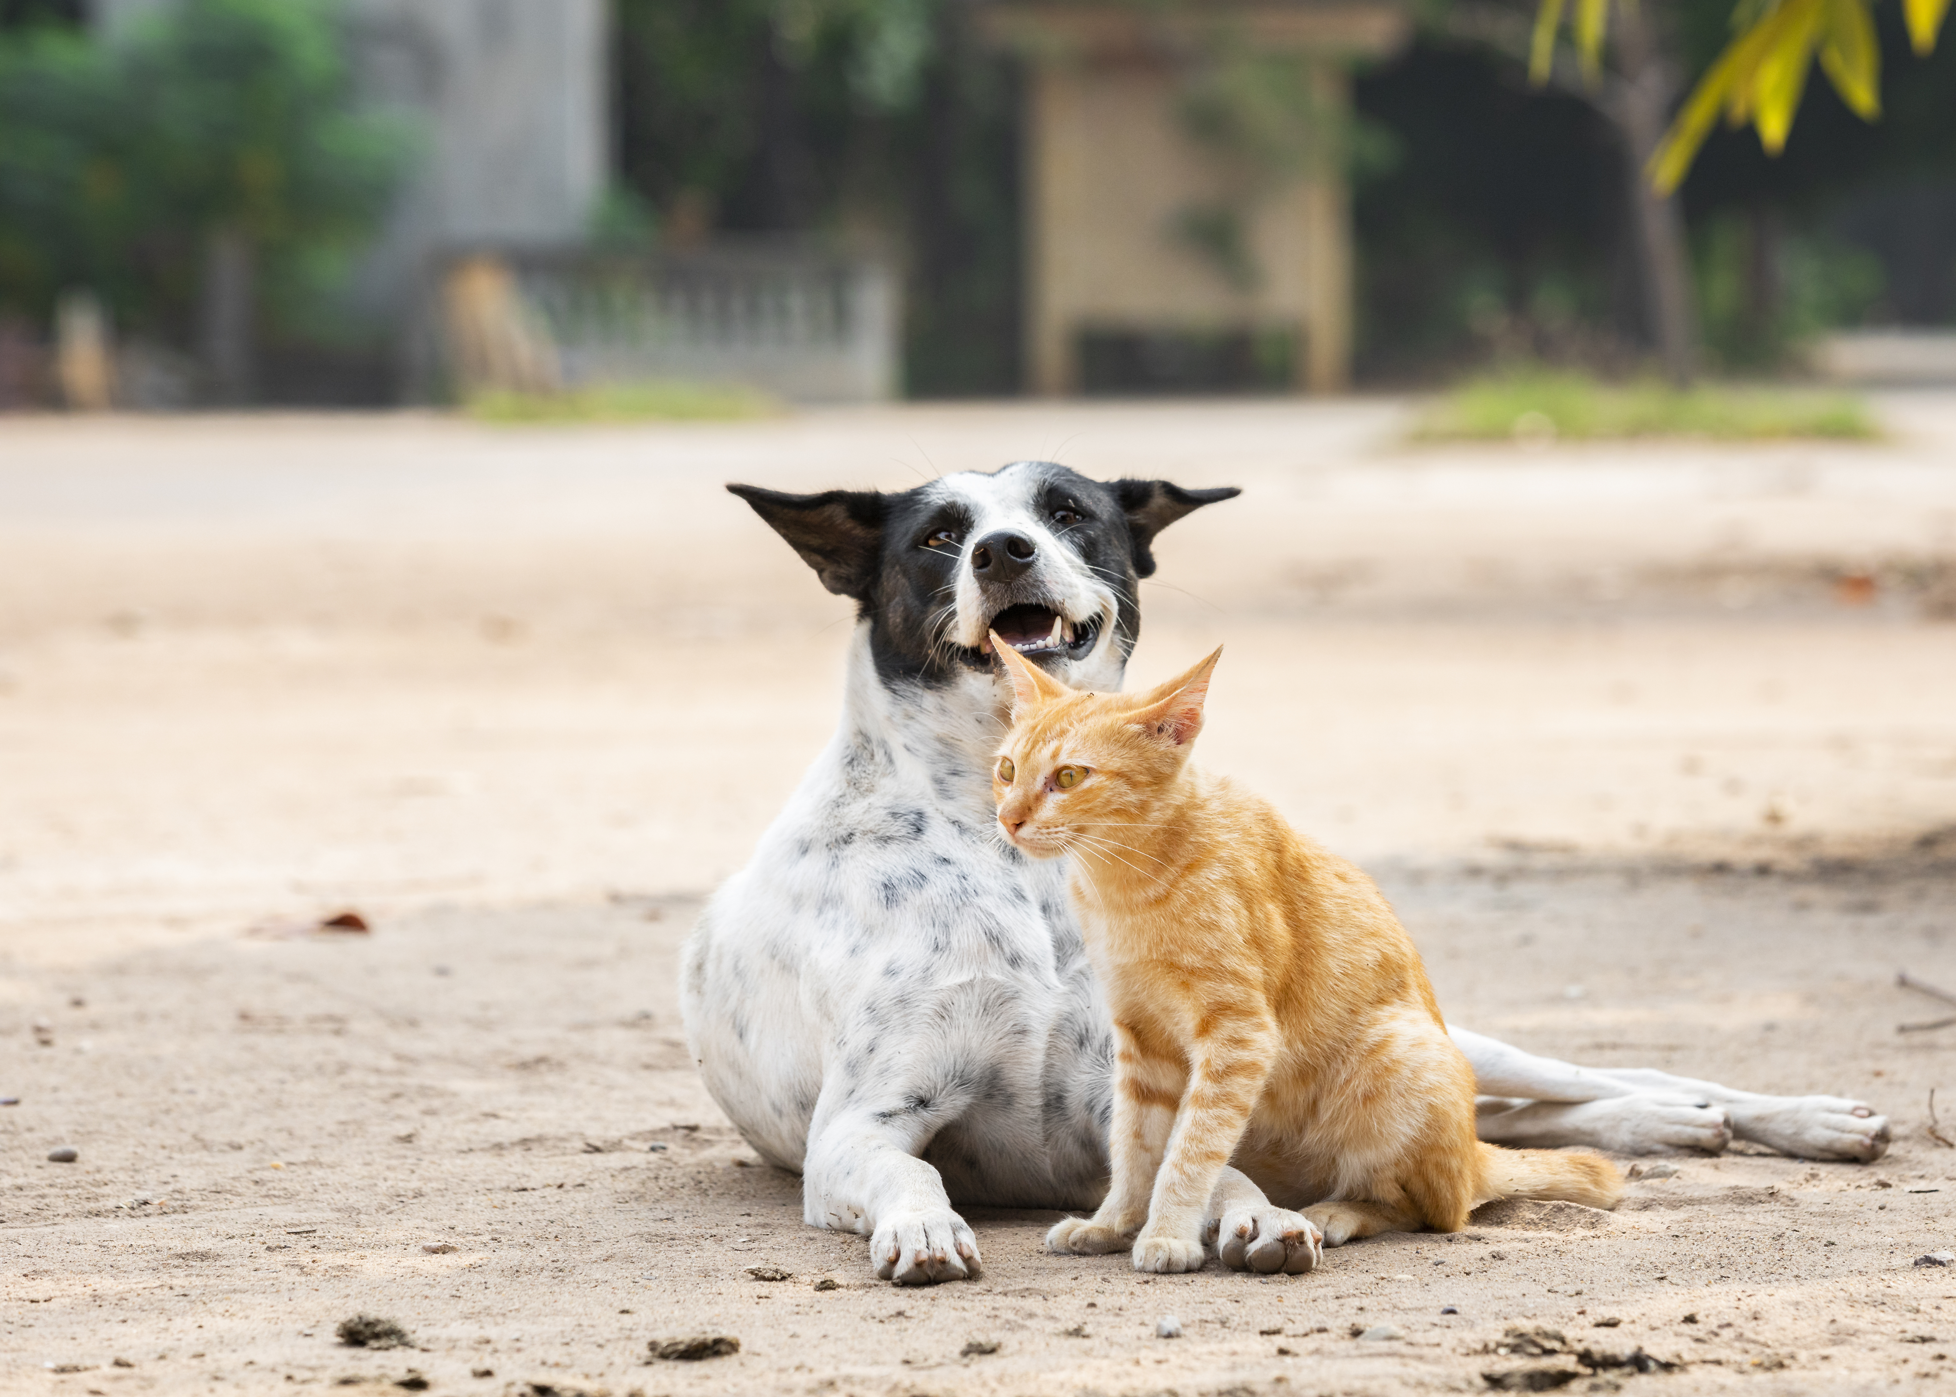
Resources on compassion fatigue
http://compassionfatigue.org/cfap-materials.html
https://sheltermedicine.vetmed.ufl.edu/education/continuing-education/compassion-fatigue-strategies/
https://www.goodreads.com/en/book/show/35881184
https://www.goodtherapy.org/blog/running-low-on-empathy-how-to-heal-from-compassion-fatigue-1115197
Meditation apps: Waking Up / Headspace / Calm

Slide 12
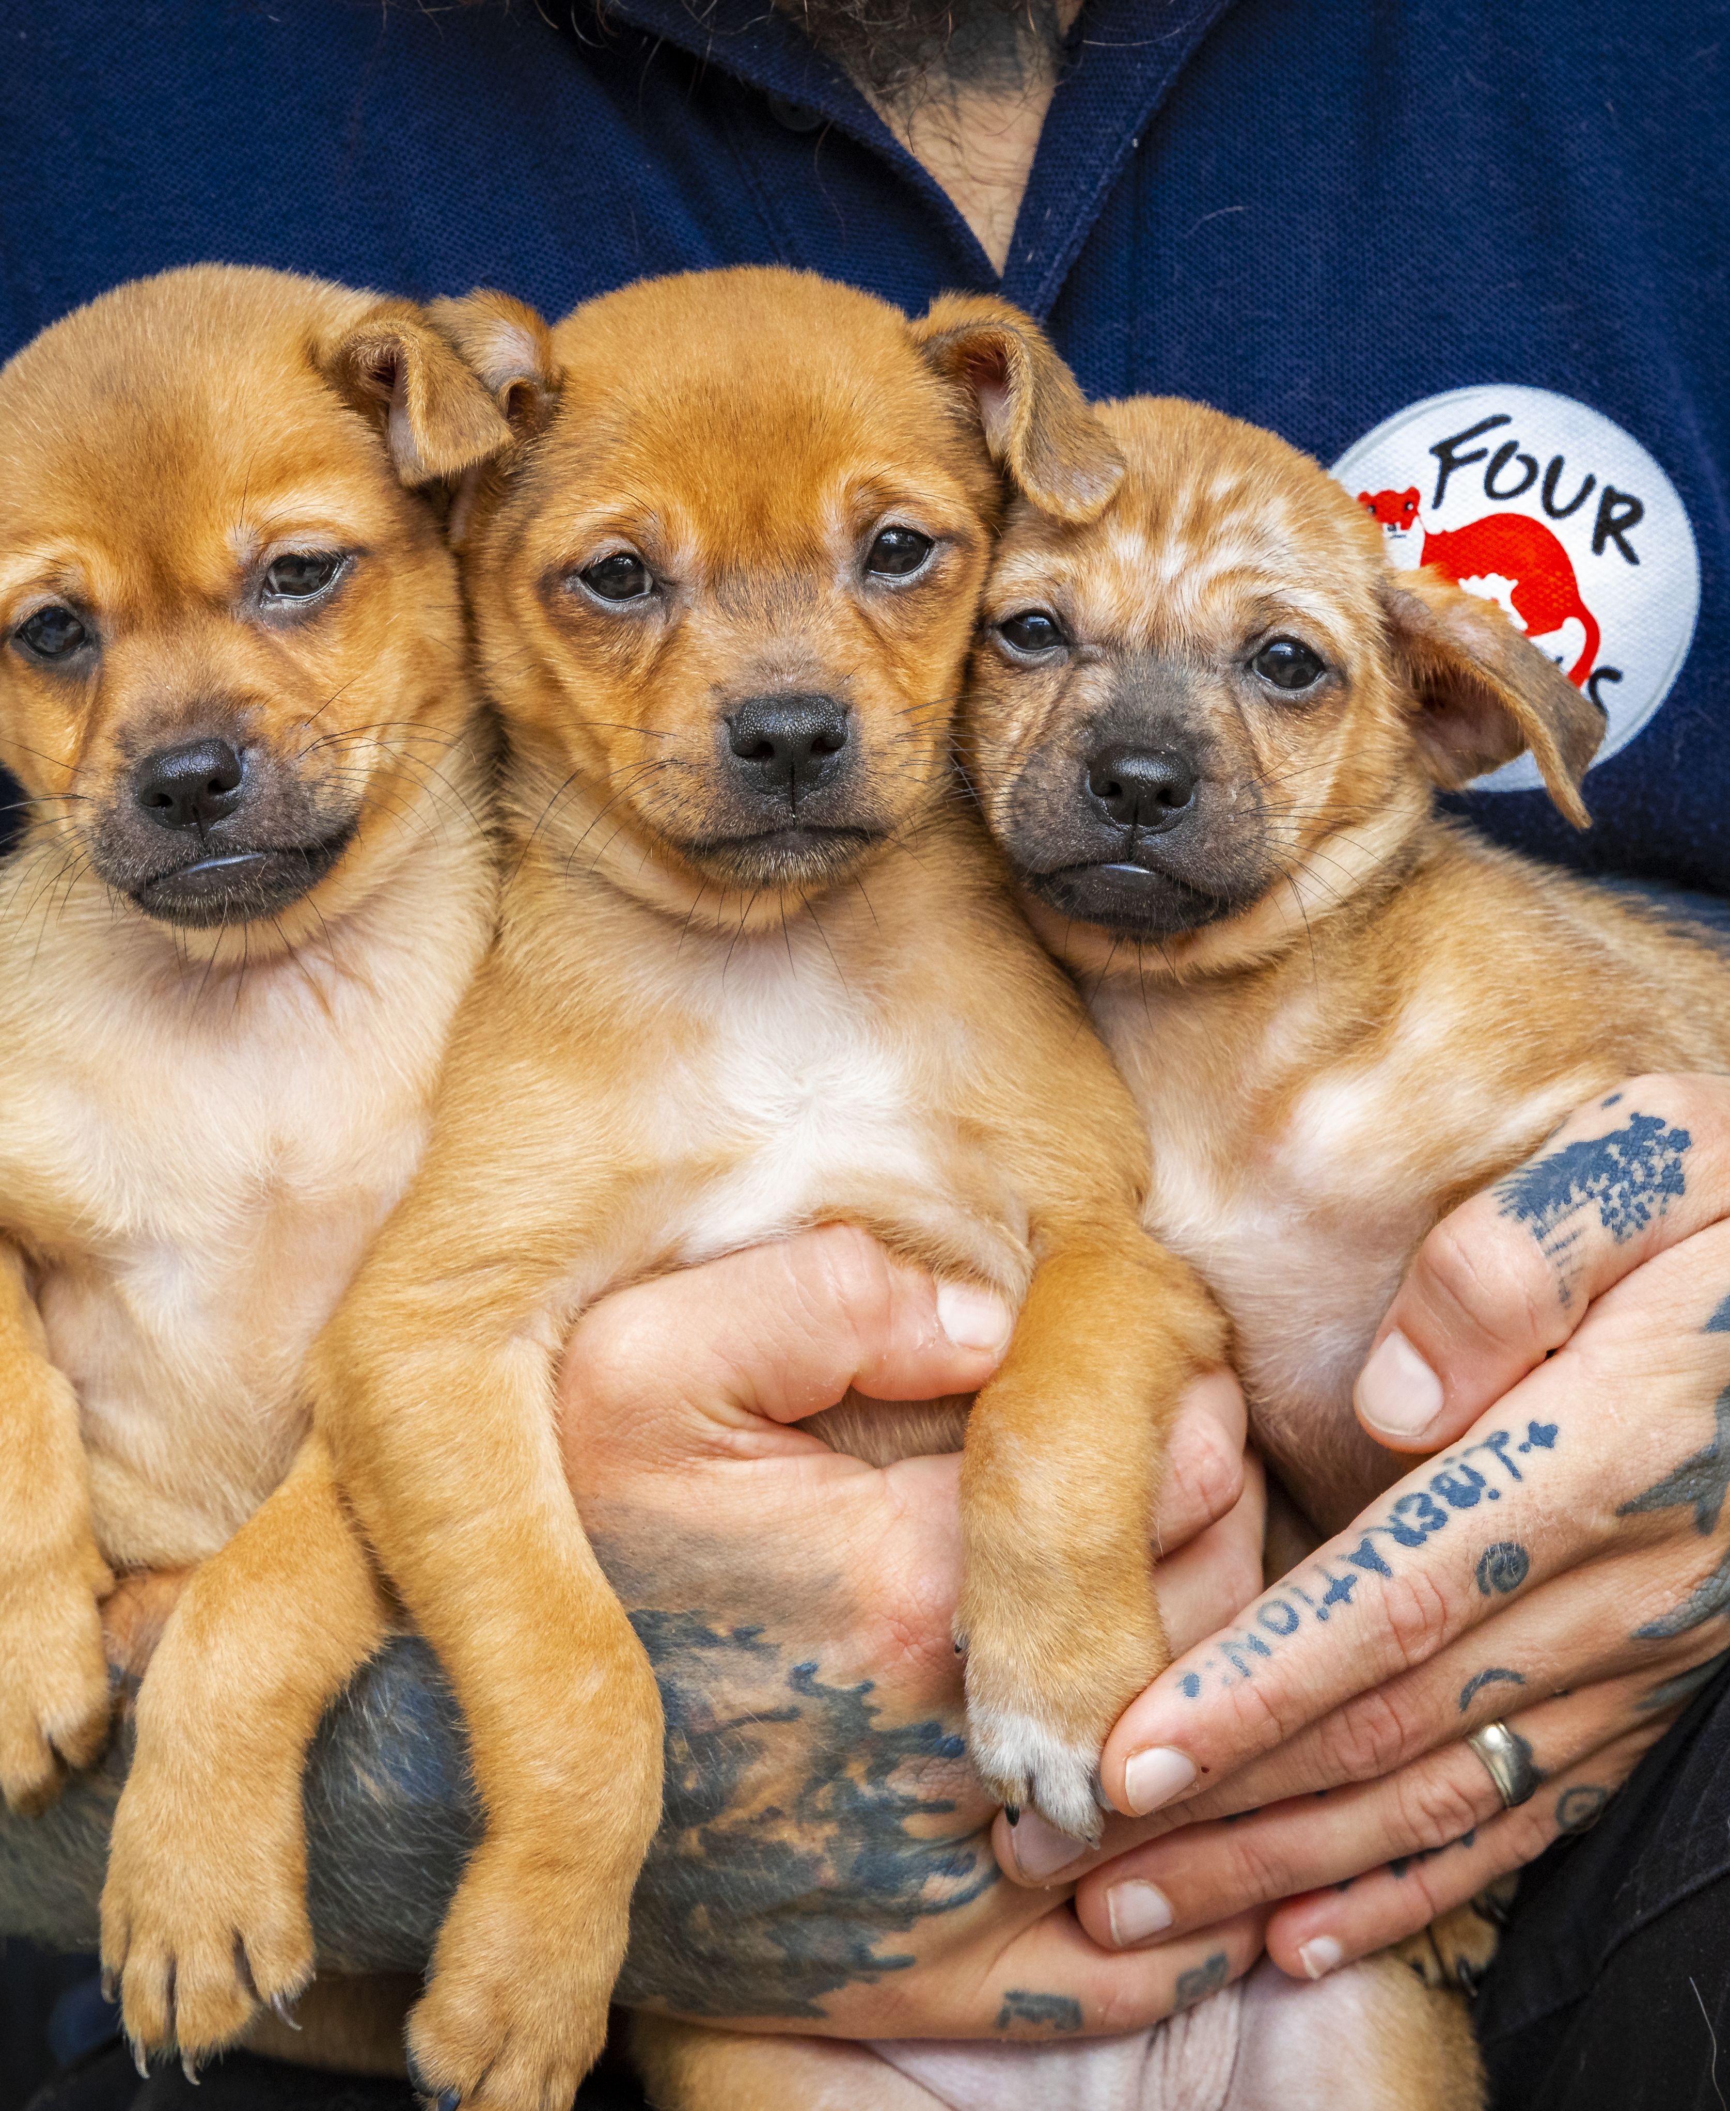
Thank you for your attention!

