Slide 1
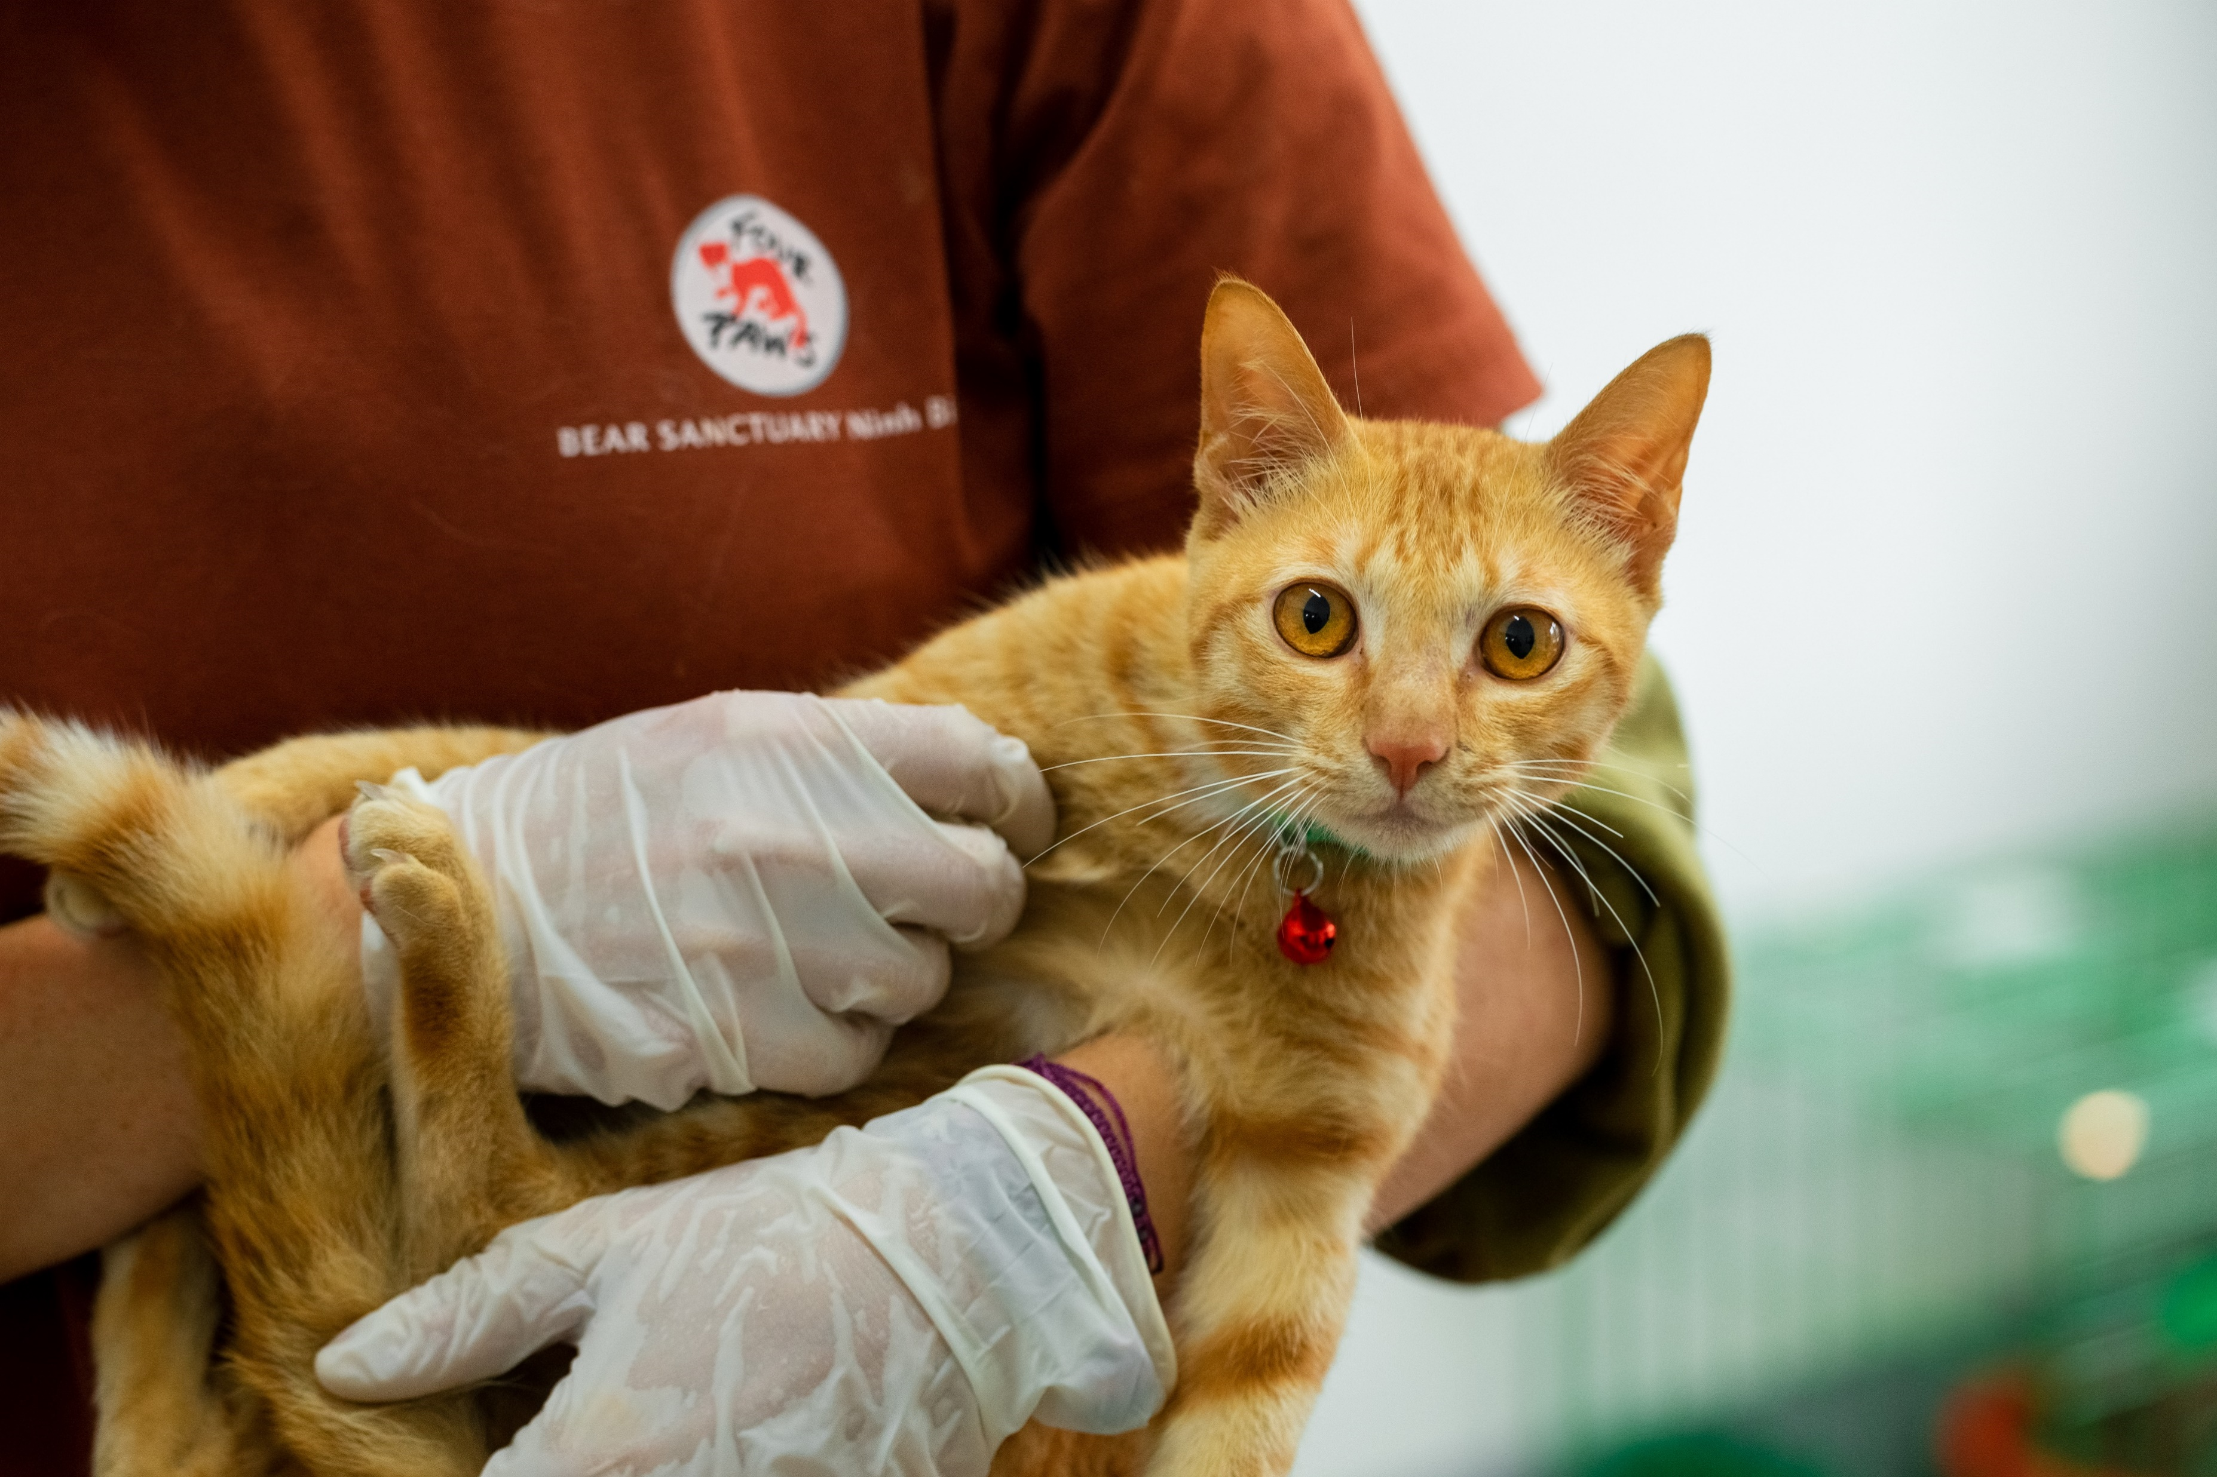
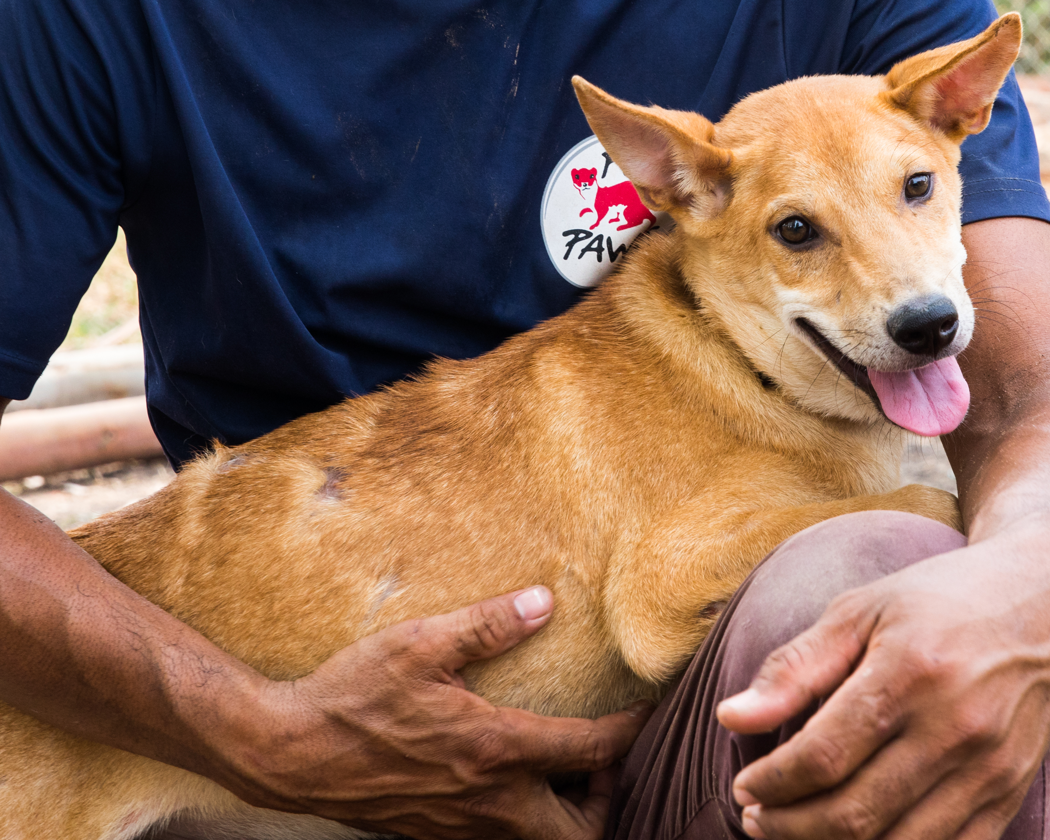
One health one welfare
Dr Karanvir Kukreja, Ms Preeyanut Glaewketgarn and Ms Savy Phan
IPB International Convention Center, Bogor, West Java, December 7th, 2023

Slide 2
OUTLINE
Introduction
One Health
One Welfare
One Health and One Welfare
Why is this important?
DCMT and One Health/One Welfare aspects
Going forward

Slide 3
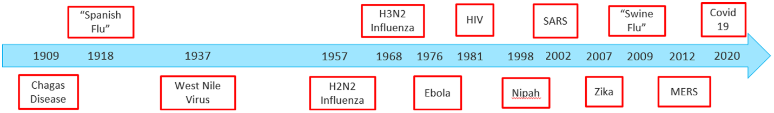
Introduction
    Over the past century, increasingly dramatic evidence of the complex relationship between humans, animals and the environment in regards to our health and welfare
    More and more diseases emerging with increasing frequency
    The following timeline gives some indication of the zoonotic disease outbreaks that have occurred over the past century
Source: G. Bedenham, A. Kirk, U. Luhano and A. Shields, The importance of biodiversity risks: Link to zoonotic diseases, Cambridge University Press (May 10, 2022), https://www.cambridge.org/core/journals/british-actuarial-journal/article/importance-of-biodiversity-risks-link-to-zoonotic-diseases/ED61579636DAAD97247851007243E658

Slide 4
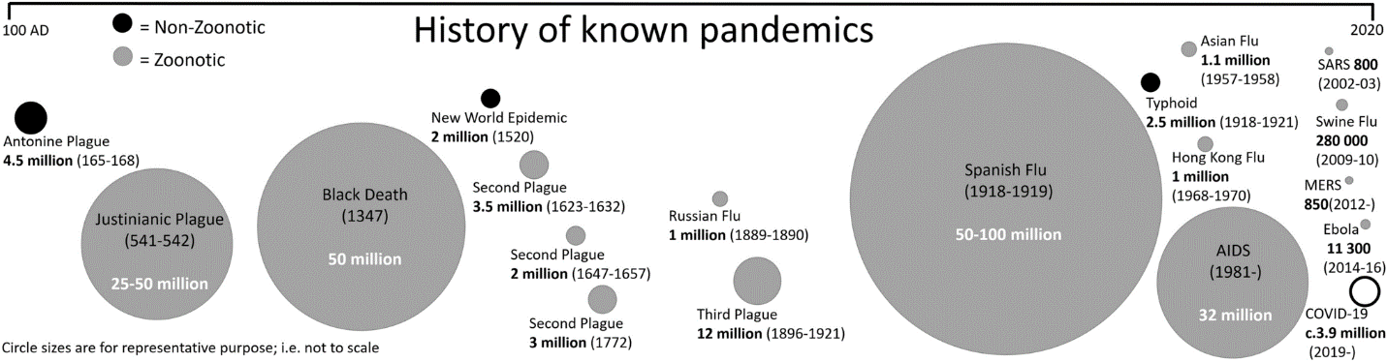
Source: Increasing risks for emerging infectious diseases within a rapidly changing High Asia, Springer Nature (July 22, 2021), https://link.springer.com/article/10.1007/s13280-021-01599-7

Slide 5
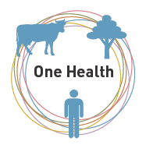
One Health
Definition by One Health High-Level Expert Panel (2022)
“One Health is an integrated, unifying approach that aims to sustainably balance and optimize the health of people, animals, and ecosystems.
It recognizes the health of humans, domestic and wild animals, plants, and the wider environment (including ecosystems) are closely linked and interdependent”
Source: One Health High-Level Expert Panel (OHHLEP), One Health: A new definition for a sustainable and healthy future, https://www.ncbi.nlm.nih.gov/pmc/articles/PMC9223325/

Slide 6
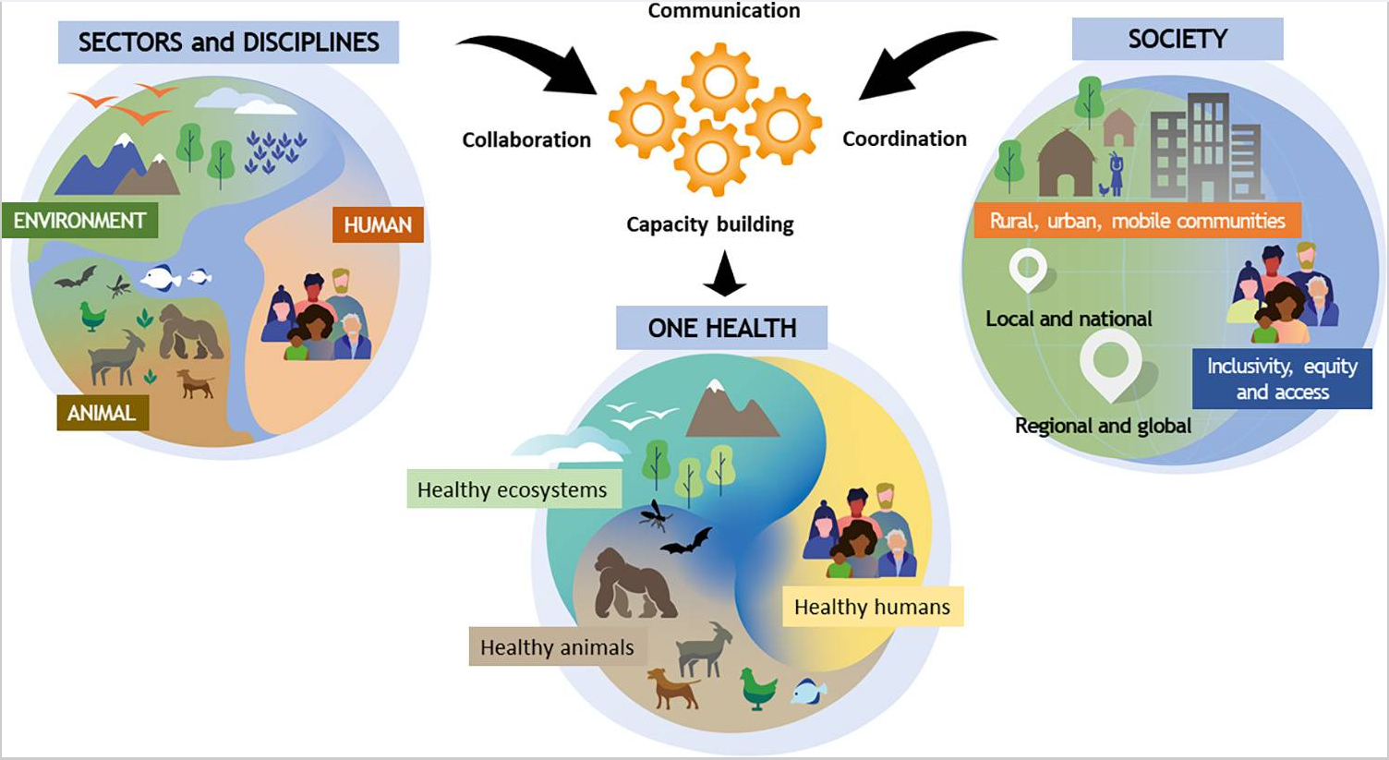
One Health
One Health toward a sustainable healthy future as developed by the One Health High-Level Expert Panel
Source: One Health High-Level Expert Panel (OHHLEP), One Health: A new definition for a sustainable and healthy future, https://www.ncbi.nlm.nih.gov/pmc/articles/PMC9223325/

Slide 7
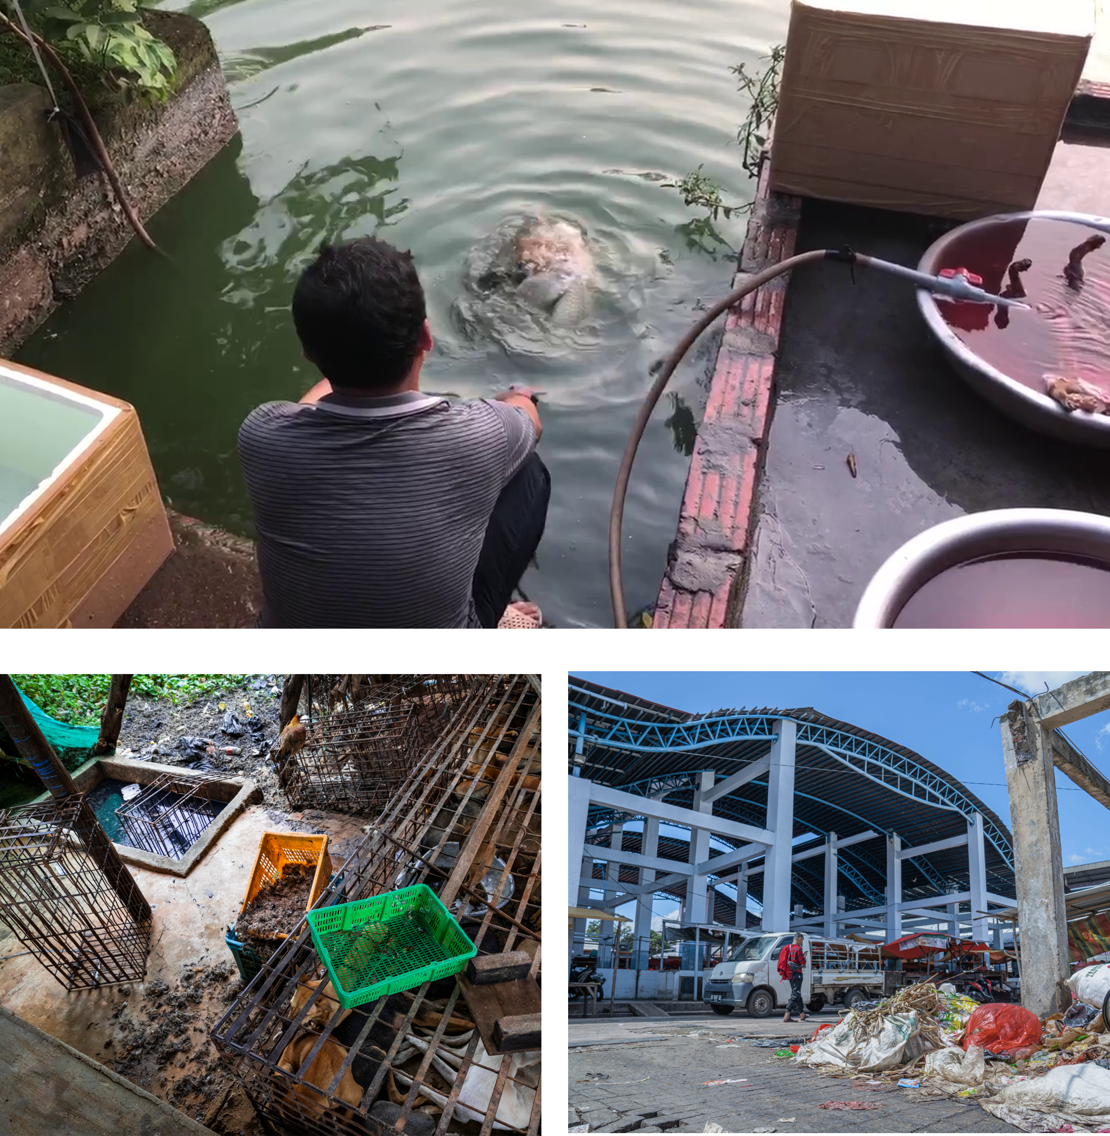
One Welfare
“One Welfare serves to highlight the interconnections between animal welfare, human wellbeing and the environment. It fosters transdisciplinary collaboration to improve human and animal welfare internationally. One Welfare also helps to promote key global objectives such as supporting food security, sustainability, reducing human suffering and improving productivity within the farming sector through a better understanding of the value of high welfare standards”
“Recognising that animal welfare, biodiversity & the environment are connected to human wellbeing”
Photos Source: FOUR PAWS/Change for Animals foundation
Source: One Welfare, https://www.onewelfareworld.org/

Slide 8
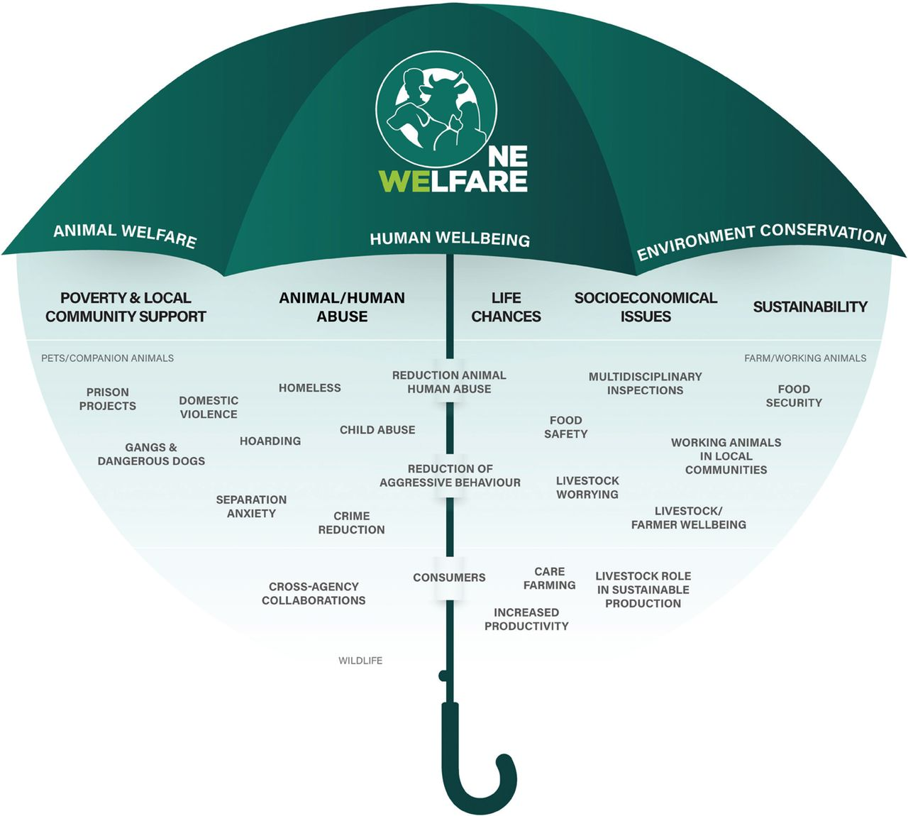
One Welfare
A One Welfare approach helps to identify and recognise the links that exist between different sectors
Source: R. García Pinillos, M. Appleby, X. Manteca, F. Scott-Park, C. Smith and A. Velarde, One Welfare – a platform for improving
human and animal welfare, Veterinary Record (October 2016), https://www.onewelfareworld.org/uploads/9/7/5/4/97544760/vetrec-2016-october-179-16-412-inline-supplementary-material-1.pdf

Slide 9
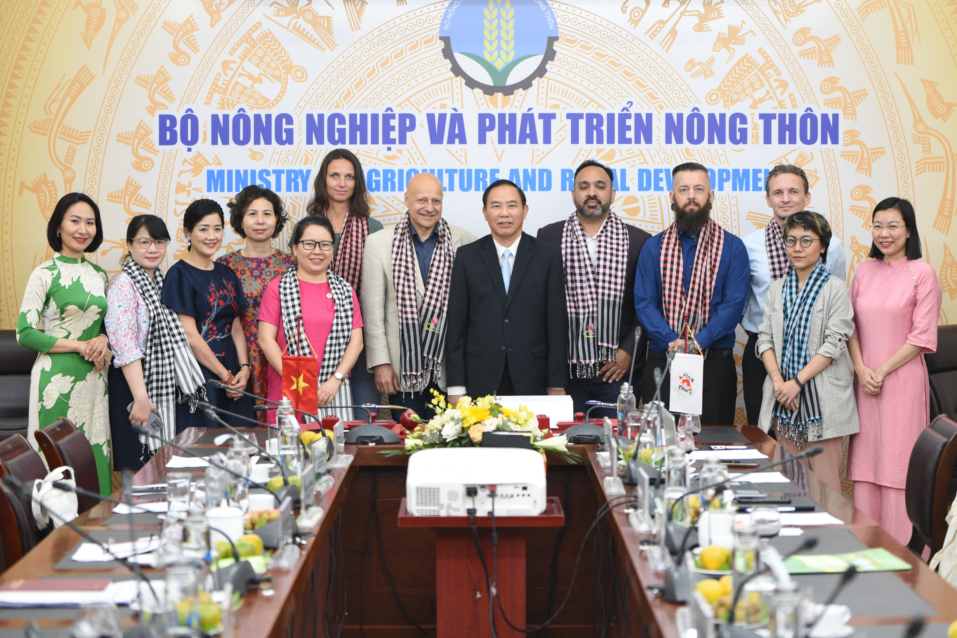

One Health and One Welfare
Complement each other
One Welfare can be considered an extension of One Health
Both are incredibly important
  Without considering welfare of humans and animals, we risk missing important areas which can be crucial in improving both human and animal health

Slide 10
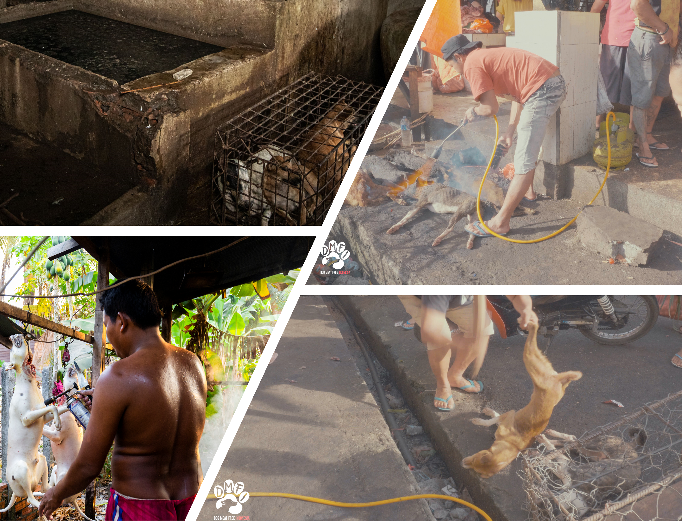
DCMT and One Health/One Welfare aspects
There are several aspects of the dog and cat meat trade relevant to One Health and Welfare
    Rabies
    Emerging Disease
    Societal Disruption
    Violence
    Environmental Damage

Slide 11

Why are one health/one welfare important?
By focusing on one aspect –
human health or animal health
  We miss the chance to find and use crucial interventions
Important to show connectedness and overall societal benefit to garner support
Innovative solutions
Pressing issues
AMR Prime Example of an urgent issue

Slide 12
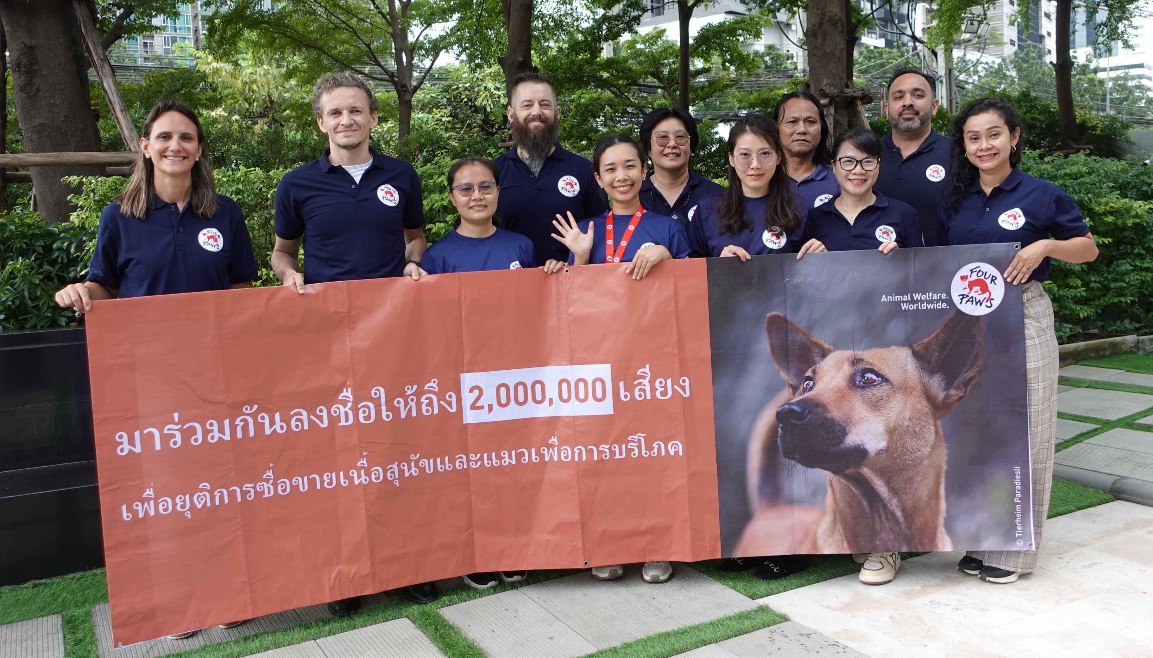
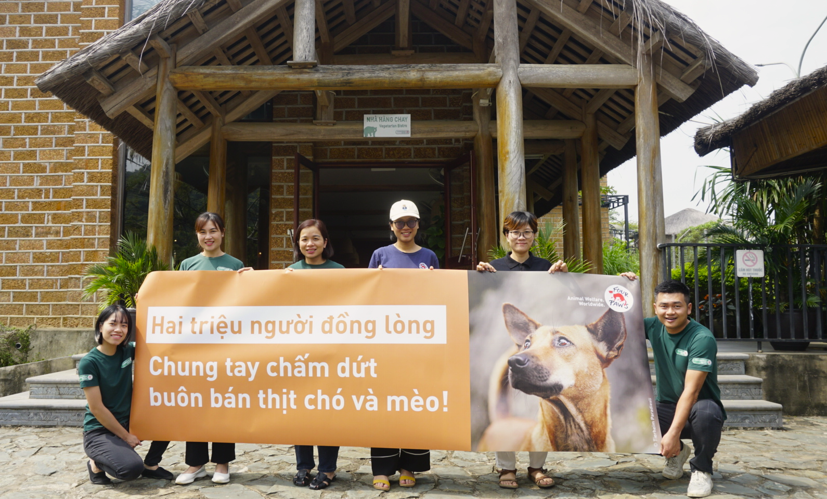

Going forward
The world keeps on taking little steps
One Health and One Welfare, Our Wellbeing and Our Planet – all are connected
Big changes are needed - together we can do this

Slide 13
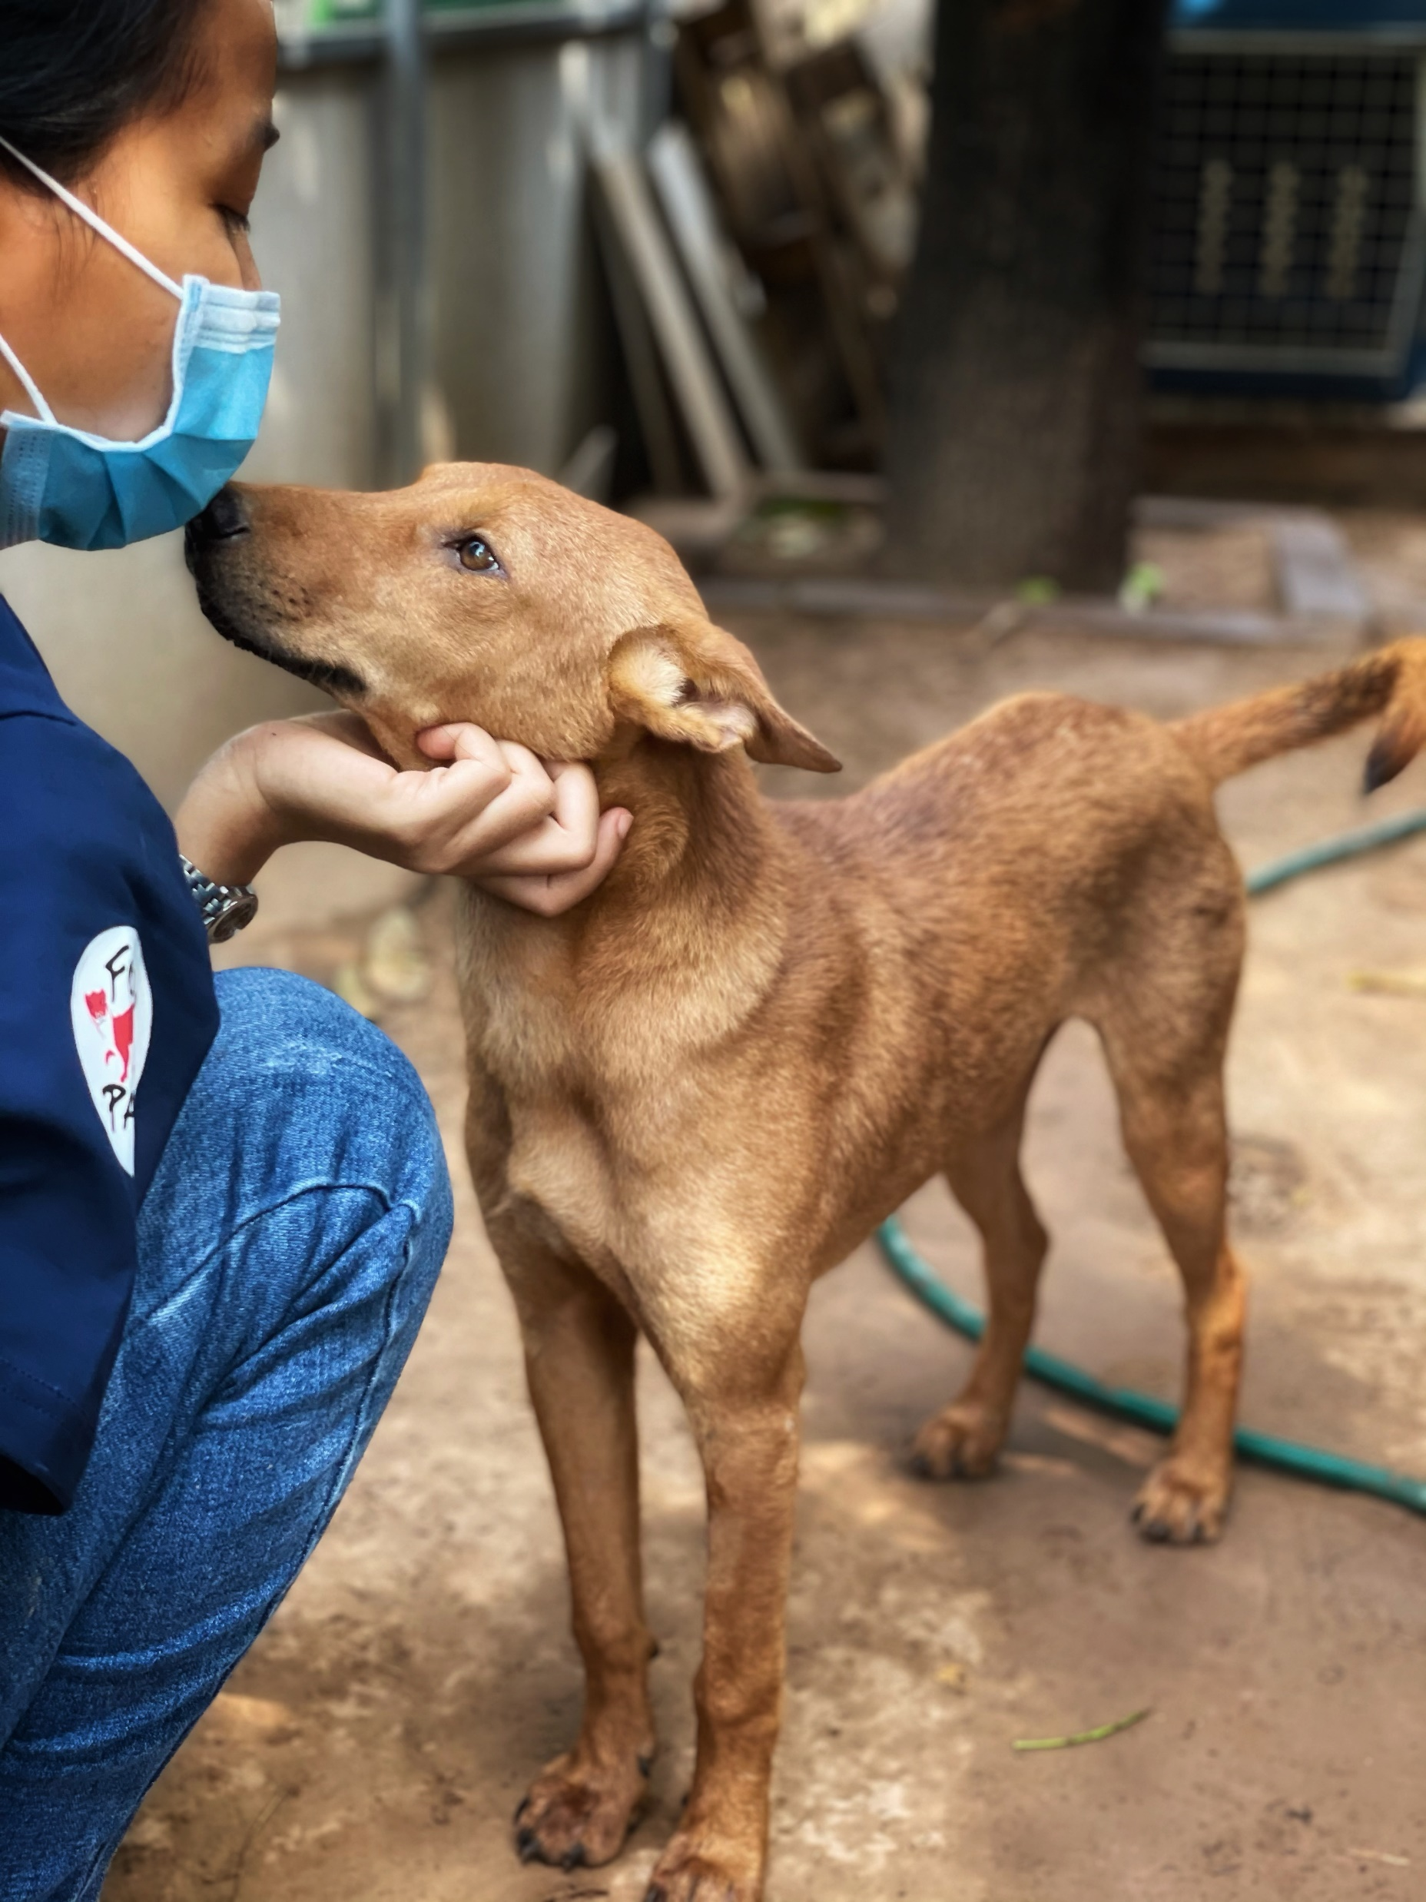
Thank you for your attention!

